Slide 1
Lecture 9
The differences between cities, inequality and generating processes
9.1 The differences between cities: scale independent performance indicators
IUS 4.1
©Luís M. A. Bettencourt 2024 @BettencourtLuis bettencourt@uchicago.edu

Slide 2

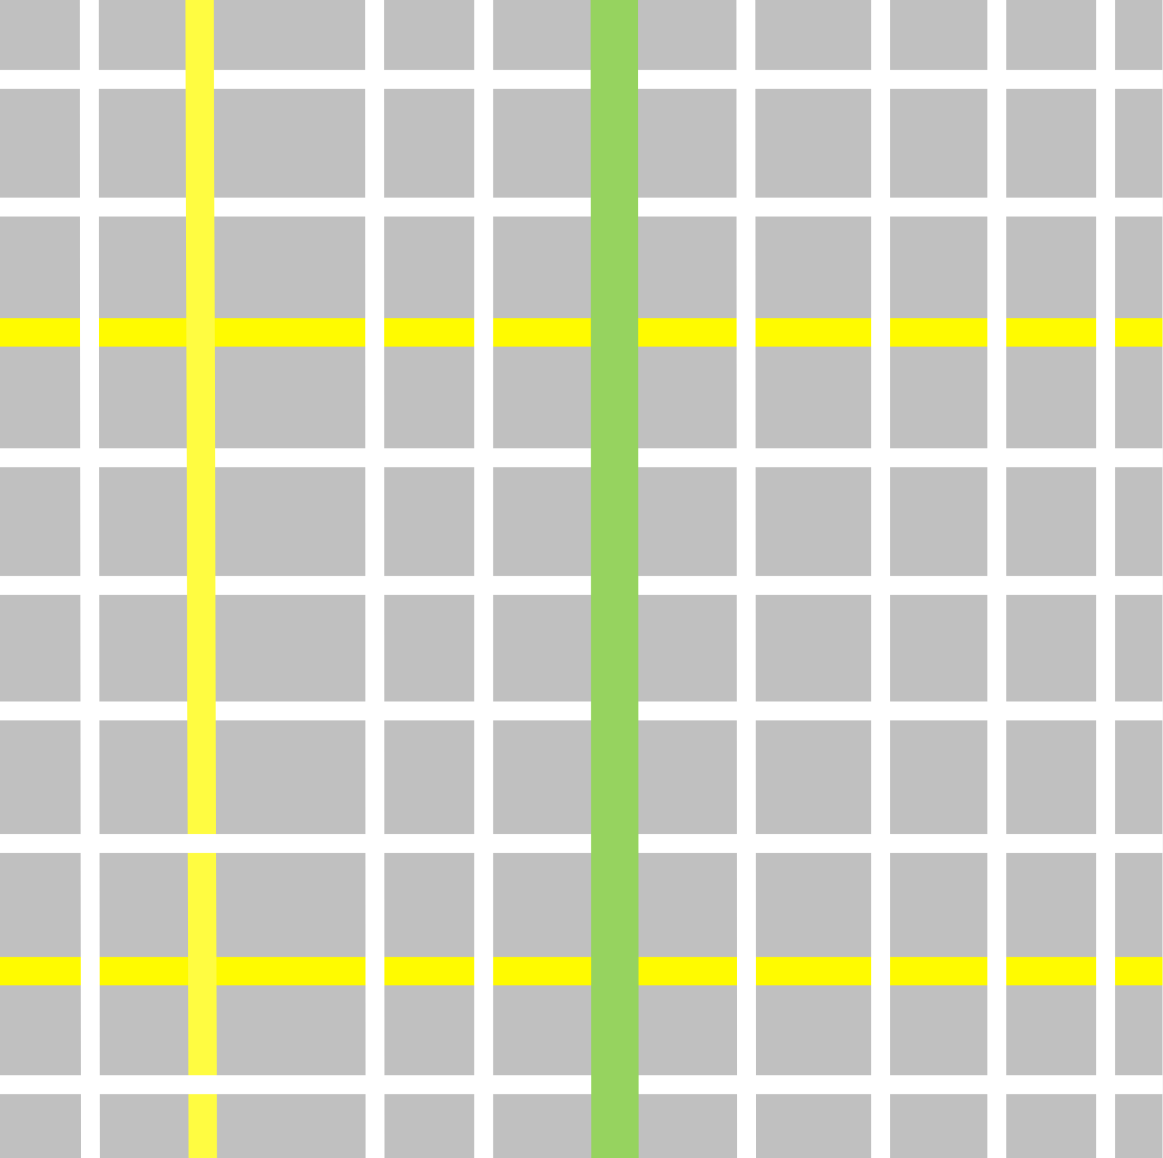








Health
Love
Money
Education
Fun
Food
Services
…
IUS Fig 3.10
…which is embedded in spacetime via life paths (time geography)
Notes:
And let’s put these interactions in the space-time of the city. To do this, we introduce a beautiful (and intuitive) concept from ‘time geography’ called the life path (this is the person’s trajectory in (urban) space-time; in physics the same concept is known as the worldline). Every one has a worldline, and big tech companies will keep track of yours, if you let them. This is not an abstract concept: you can measure life paths, e.g. with mobile devices.

Slide 3
How about the differences between cities?
How to measure the effects of history, agency and accident?
How to build place-specific urban “performance” indices?
We have identified many of the common factors of being a city :
Defines what a city is in general terms —> Theory
This defines a stereotypical city of a given size:
gives a frame of reference for understanding diversity and difference
—> Policy and Practice
Progress:
A wider and more comprehensive view of cities (beyond built environment, economics, geography, sociology)
Not just a 19th century industrial city
A generalizable picture across geography, levels of development, culture, political and economic systems
Notes:
Scaling gives us the expected mean properties of each city, averaged over their entire population, as a function of population size. We have found a range of general properties of cities in this way. Now we want to look at the deviations from this average city : we want to start looking at the flavor of each city.
Note that these are two faces of the same questions: we can only identify what is special about a city by contrast with a measure of what is general.

Slide 4
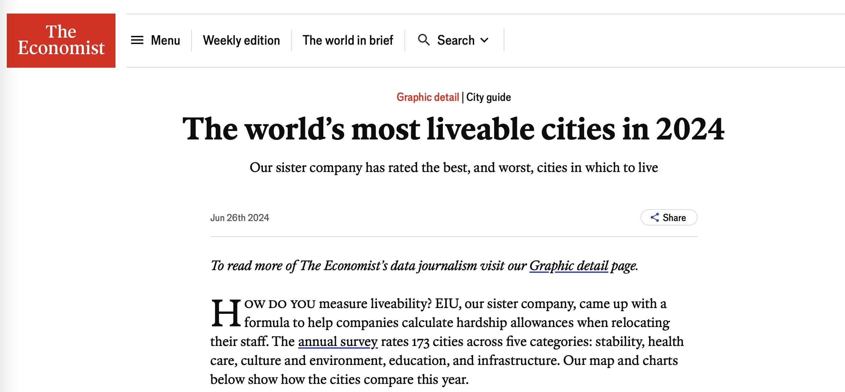
Does this make any sense?
https://www.economist.com/graphic-detail/2024/06/26/the-worlds-most-liveable-cities-in-2024

Slide 5
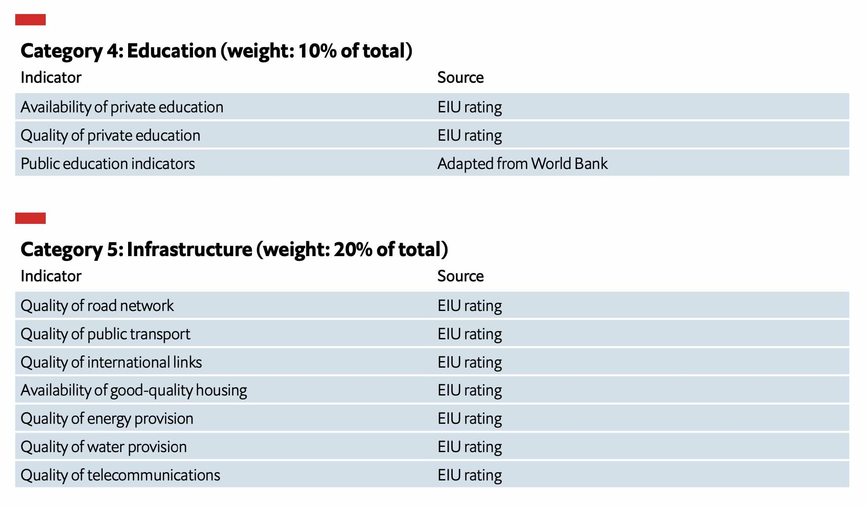

Slide 6
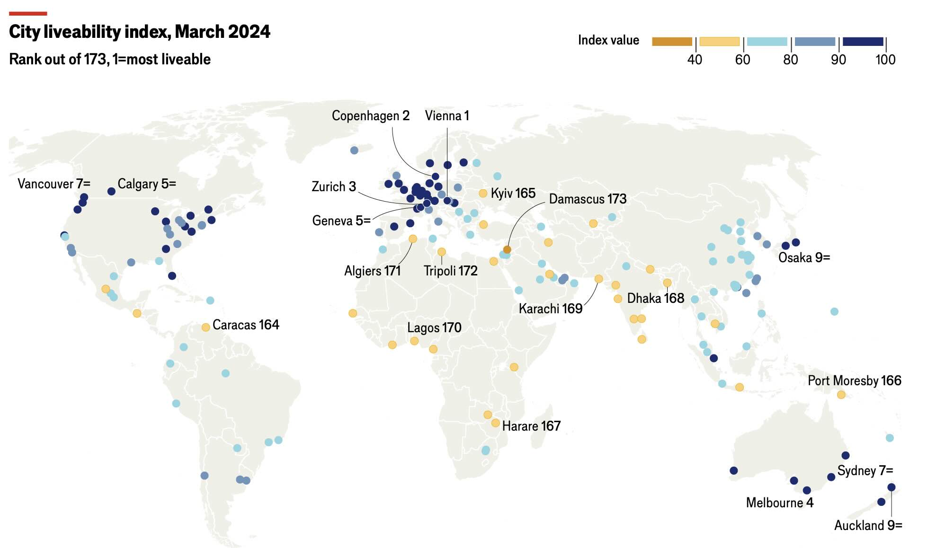

Slide 7
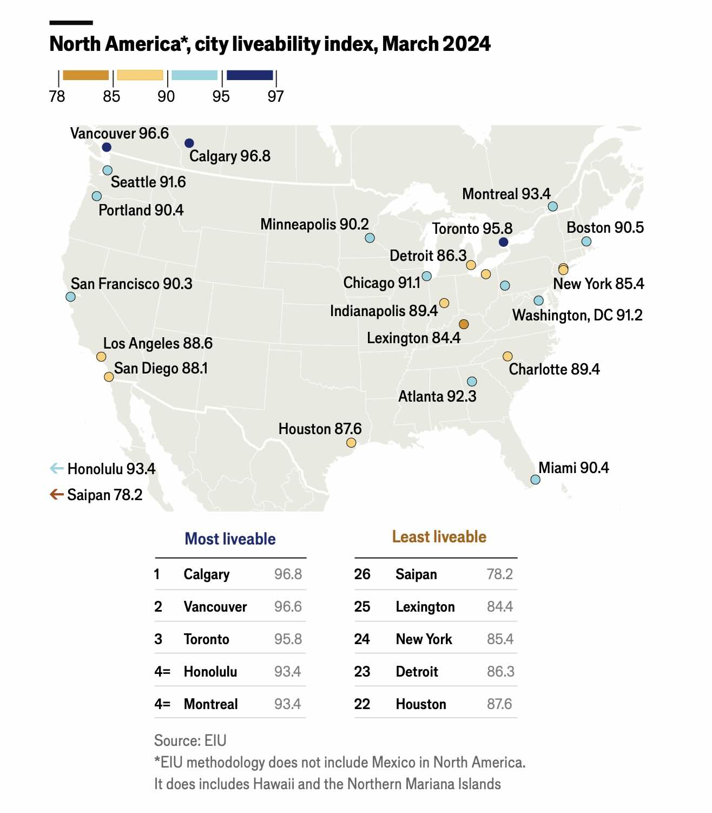

Slide 8
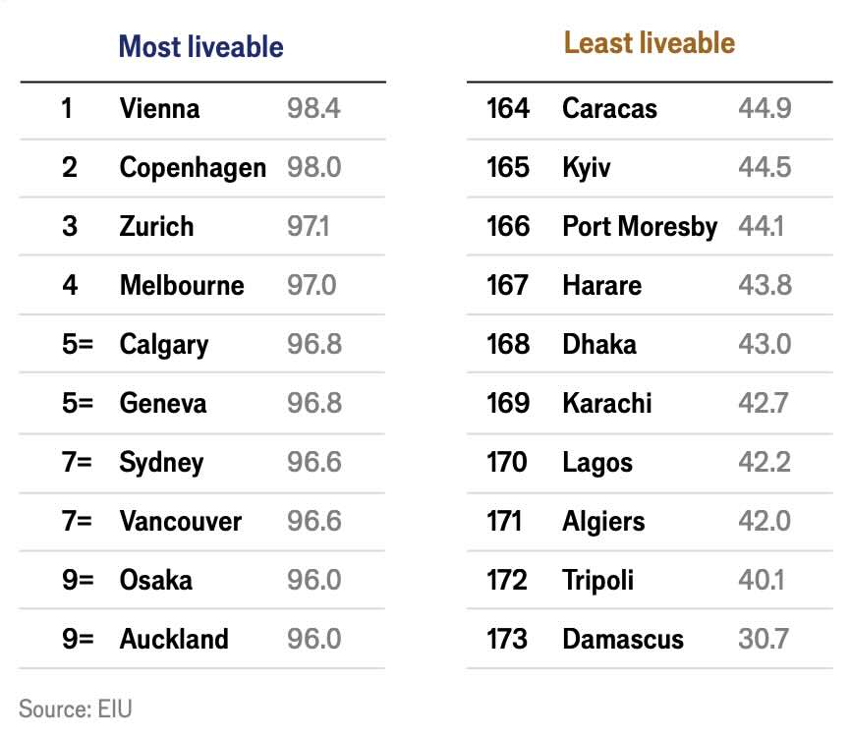
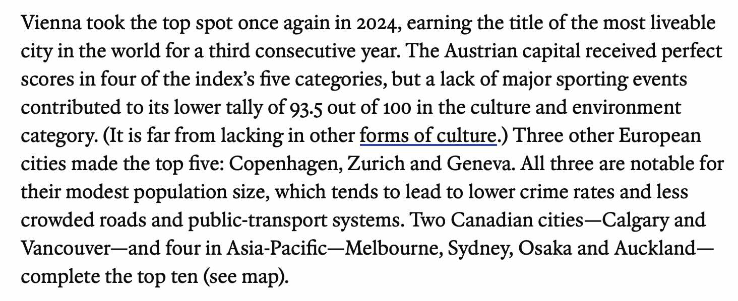

Slide 9
Benchmarking cities
Per capita Indicators versus Scaling Indicators
Because Properties of Cities are Non-linear on populations size
per capita rates give us a distorted view that
mixes together general urban effects and place specific characteristics
$$Y=Y_{0}N^{1+δ}→y=\frac{Y}{N}=Y_{0}N^{δ}$$
GDP, Wages, Crime, Patents, COVID cases, density …
tend to increase as per capita rates with city size
$$A_{n}=A_{0}N^{1-δ}→a_{n}=\frac{A_{n}}{N}=A_{0}N^{-δ}$$
Built ares, area of roads, pipes, infrastructure
tend to decrease as per capita rates with city size
We can use scaling relations to subtract general effects and identify unique properties of each place
Notes:
One additional motivation for doing this, is that urban indicators (of “performance”) are often reported on a per capita basis, but scaling tells us that this is a biased measure as certain properties increase on average per capita with city size (superlinear) and others decrease (sublunar). In order to compare cities of different sizes we need to subtract their nonlinear scaling expectation from their actual measurement of performance.

Slide 10
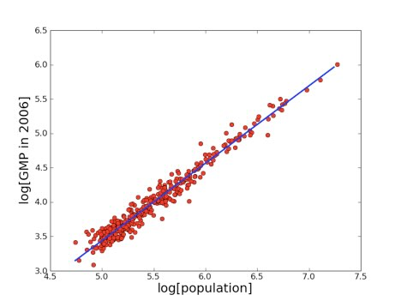
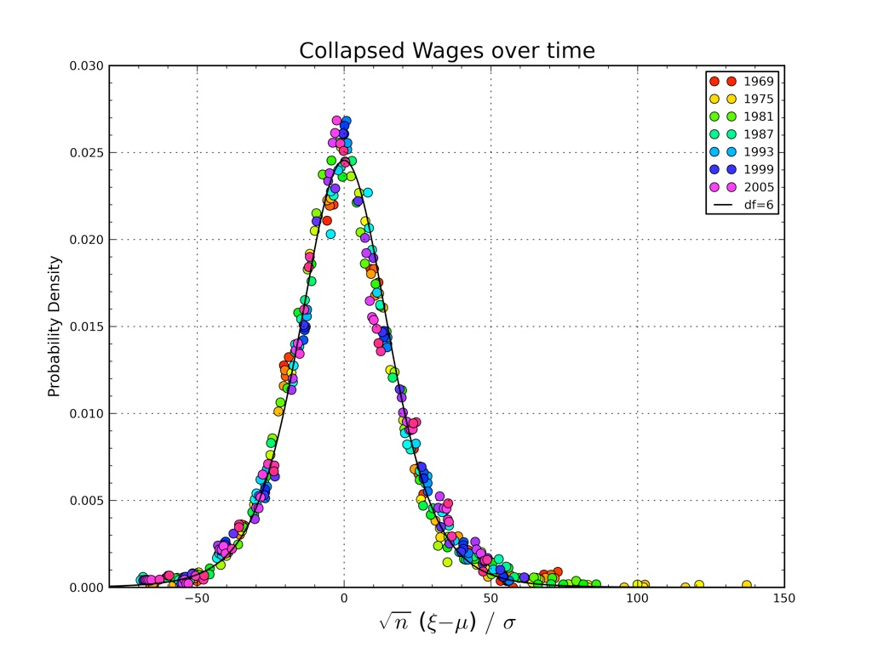
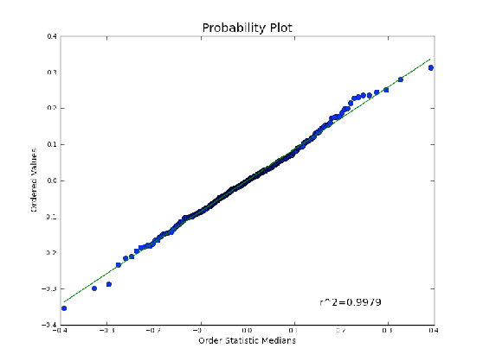
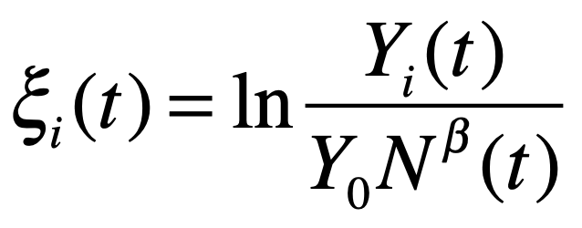
Deviations from Scaling
Scale Adjusted Metropolitan Indicators: SAMIs
$$ξ_{i}$$
$$Y_{i}=Y_{0}N_{i}^{β}e^{ξ_{i}}$$
What is the structure of each city’s deviation?
What is Its “local flavor” of a city?
https://journals.plos.org/plosone/article?id=10.1371/journal.pone.0013541
Notes:
Motivated by this idea, we call these deviations from scaling SAMIs; but they are simply the residuals \xi_i of a scaling fit in log variables, as shown on the left.
On the right, I show the statistical distribution of these residuals. Interestingly, they well described by a simple Gaussian (normal) distribution ! In the original (unlogged variables) this means that the statistics of these residuals (deviations from scaling) is approximately lognormal.

Slide 11
Centering Data
Take the averages:
$$⟨lnY⟩=\frac{1}{N_{c}}\overset{N_{c}}{\underset{i=1}{∑}}lnY_{i}$$
$$⟨lnN⟩=\frac{1}{N_{c}}\overset{N_{c}}{\underset{i=1}{∑}}lnN_{i}$$
Sample average
Take the scaling relation:
$$Y_{i}=Y_{0}N_{i}^{β}e^{ξ_{i}}$$
$$lnY_{i}=lnY_{0}+βlnN_{i}+ξ_{i}$$
scaling relation
take the logs
take the average
$$⟨lnY⟩=lnY_{0}+βlnN_{i},⟨ξ⟩=0$$
$$lnY_{i}-⟨lnY⟩=β(lnN_{i}-⟨lnN⟩)+ξ_{i}$$
Centered Variables
A linear regression centeres at (0,0). Only 1 parameter left: slope
Notes:
Here’s another trick (which I showed before), which is to “center” data, so that we remove temporal dynamics of the scaling pre-factor and of population. This means that each data cloud (in log-log variables) is centered at the origin of the plot (0,0).

Slide 12
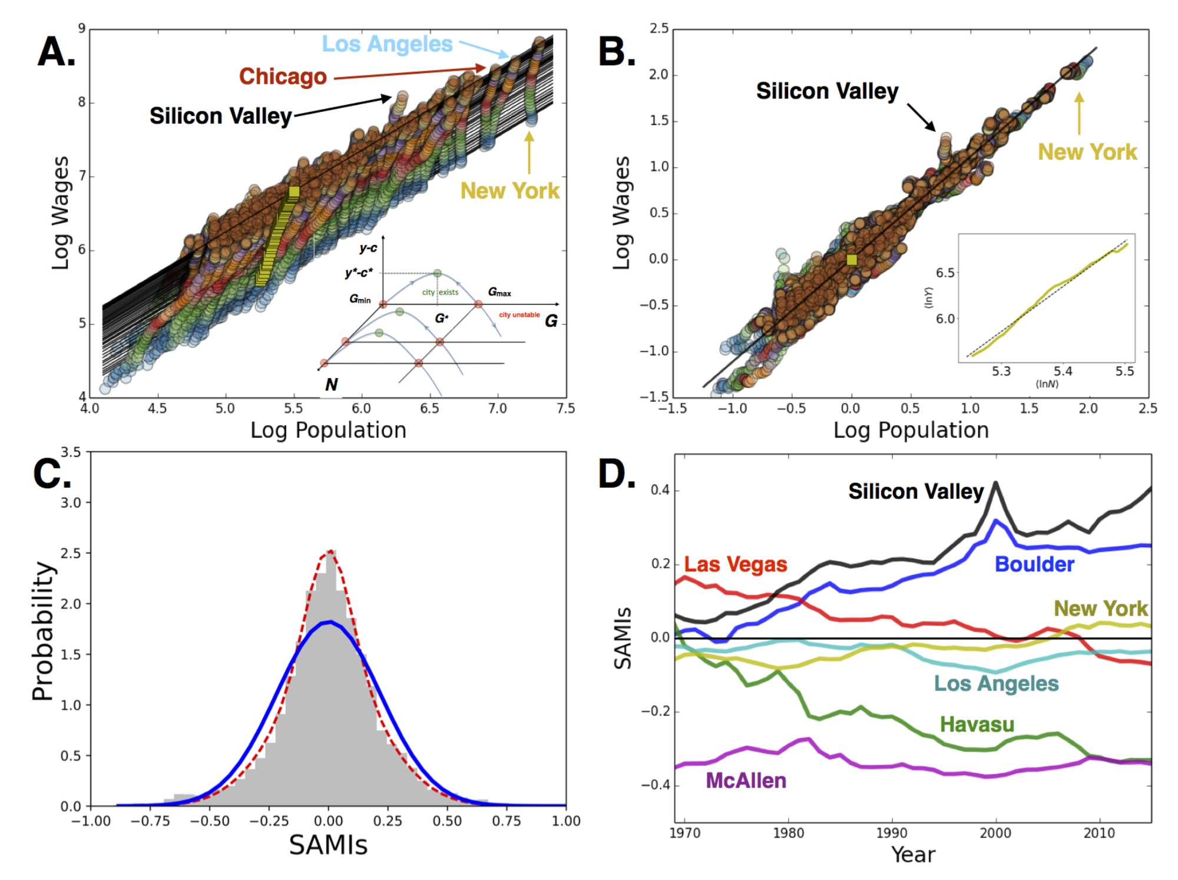
centering
$$⟨ξ⟩=0$$
$$ξ_{i}(t)$$
Normal
Notes:
This is shown here graphically: A shows data for wages of UD MSAs across time, from 1969 to 2016. The yellow squares are the centers of each year’s data cloud. From A. to B. we center the data. The inset show the relative growth of the centers, which is a approximately a simple straight line. If you focus now on NYC you see that it has been varying just a little bit around the scaling expectation. These trajectories (for the most extreme cities) are shown in C, which cities improved and decreased in relative terms over time. We see the rise of tech cities, and the decay (in wages) of cities like Las Vegas and Havasu (AZ).

Slide 13

Notes:
It is interesting and instructive to learn about the detailed histories of each city: here’s Havasu n its own website…

Slide 14

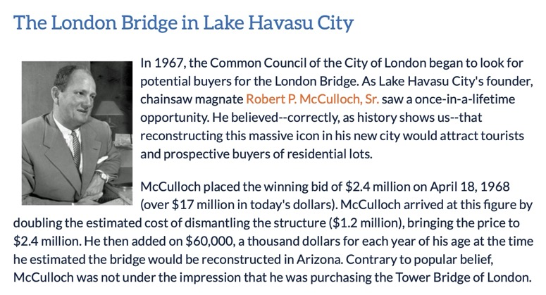
Notes:
It is (in)famous for having bought and relocated the London Bridge from London. Legend has it that they thought they were buying the more famous Tower Bridge, but I am not sure that is true.

Slide 15
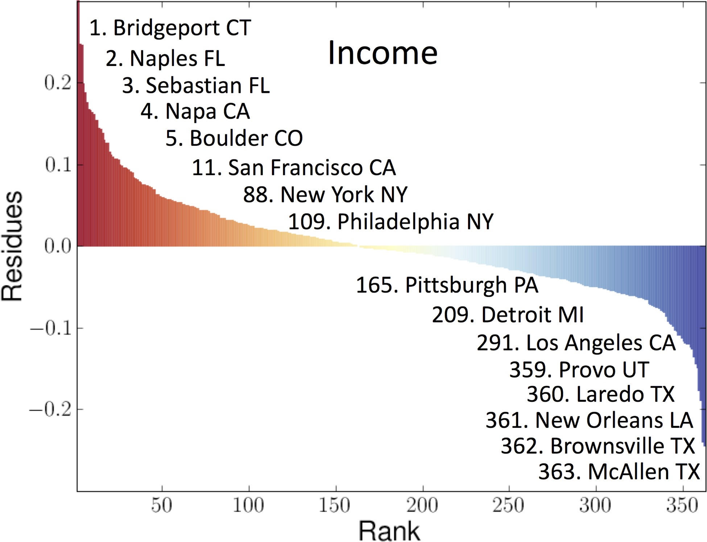
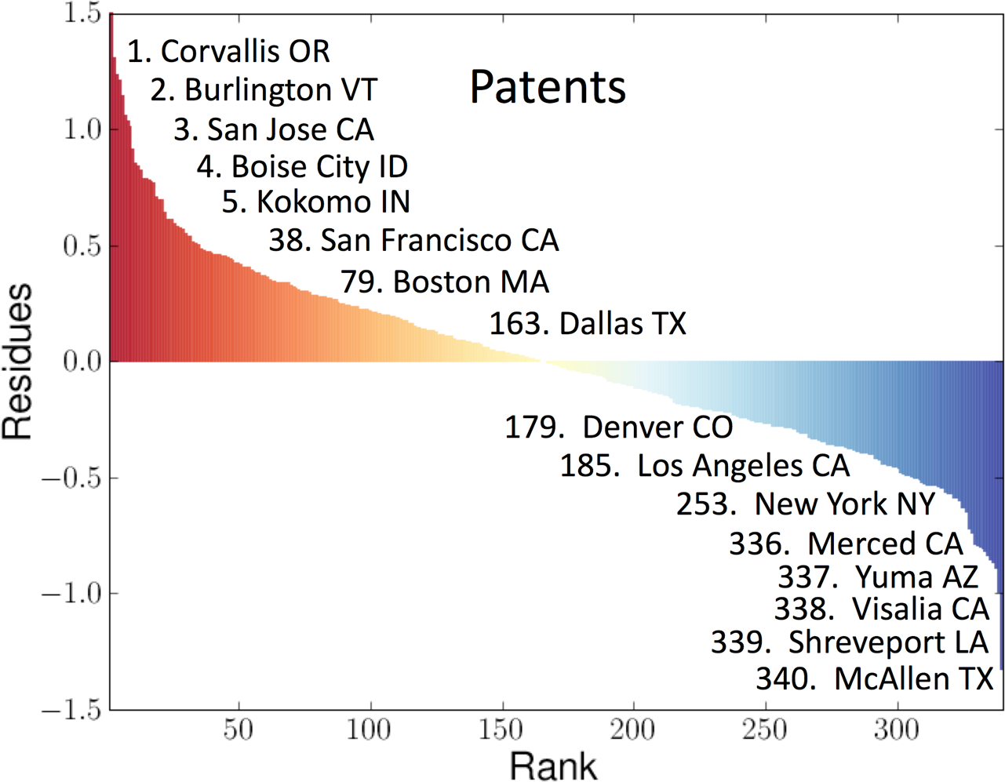
Ranking US Metropolitan Areas by Deviations from Scaling
A.
B.
$$ξ_{i}$$
$$ξ_{i}$$
Notes:
One obvious thing we can do with residuals (SAMIs) is to rank them from highest (best in this case) to lowest (worse). This provides a city size-independent measure of their performance. Each of these cities now has a particular story to be different, from company town to border town; from tax haven to tech town, to post-industrial redevelopment.

Slide 16
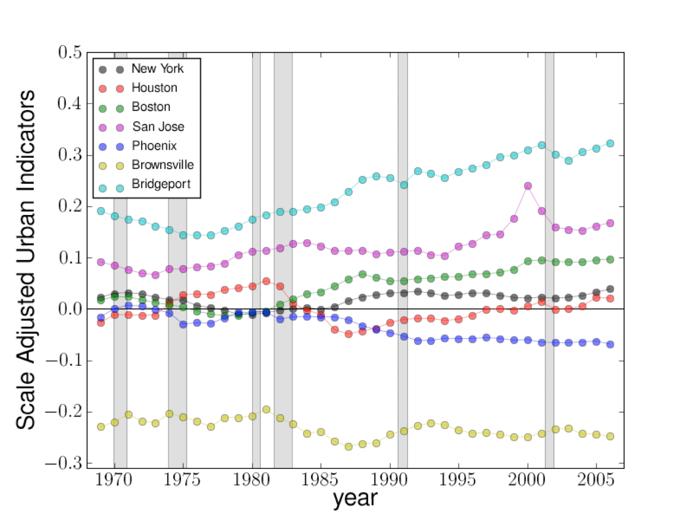
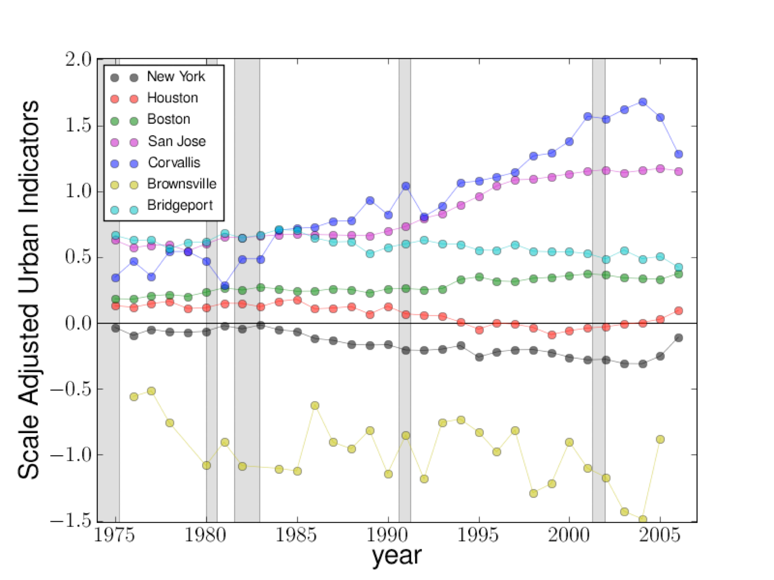
Ranking US Metropolitan Areas by Deviations from Scaling
over time
A.
B.
$$ξ_{i}$$
$$ξ_{i}$$
Notes:
We can also see (as in the figure above) how the SAMIs have changed in time, meaning how the relative performance of cities changes over time. Very few cities improve or degrade systematically, most just bump around close to zero, and this is why scaling is conserved… (we will make this point more precise below).

Slide 17
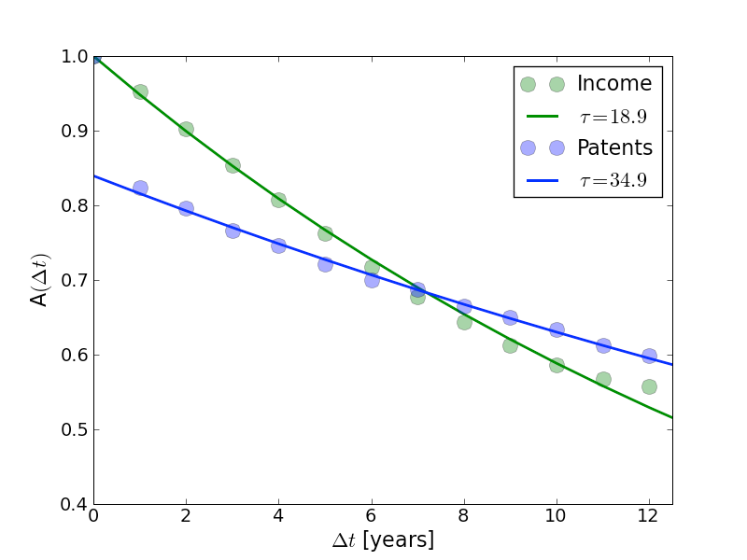
Temporal persistence of scaling deviations
Persistence times are in the order of a few decades !
Notes:
These residuals change VERY slowly in time, meaning that the relative position of cities takes about a generation to change character. Bad news for political promises of fast change: fate of cities within an urban system is more similar than it may seem.

Slide 18
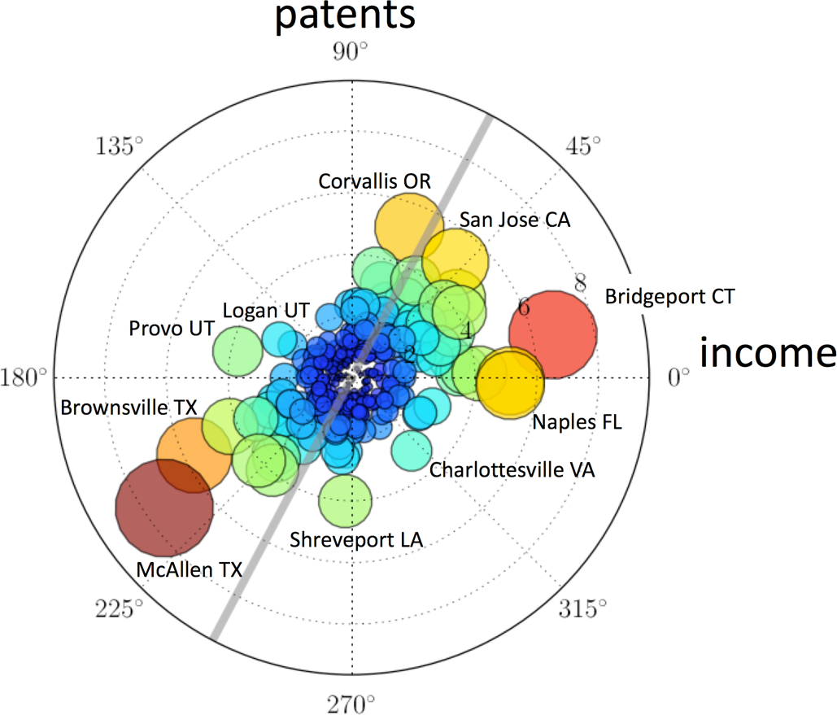
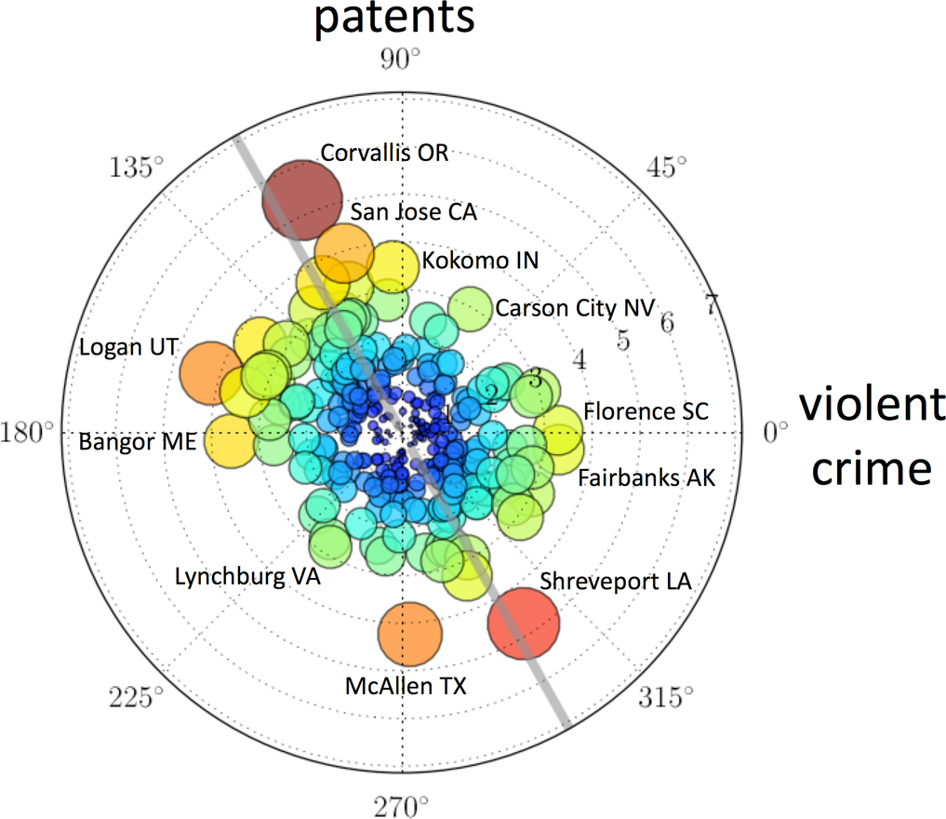
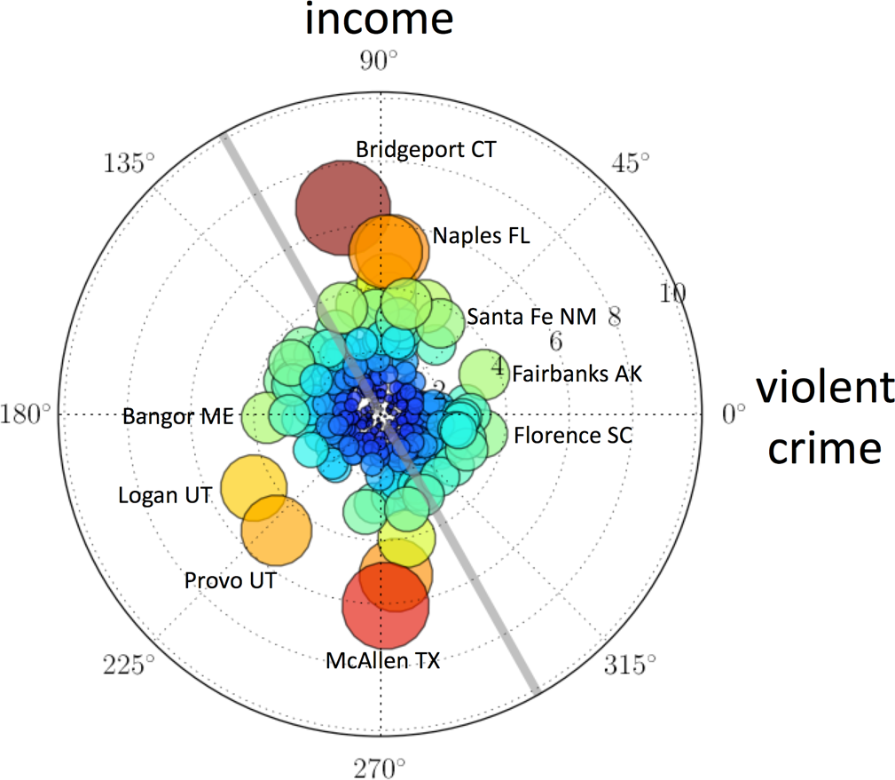
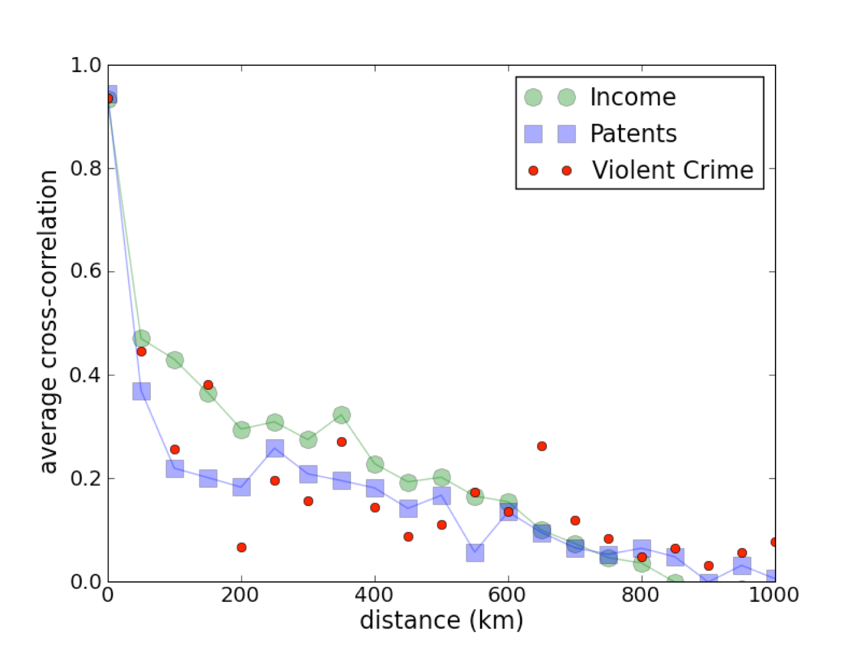
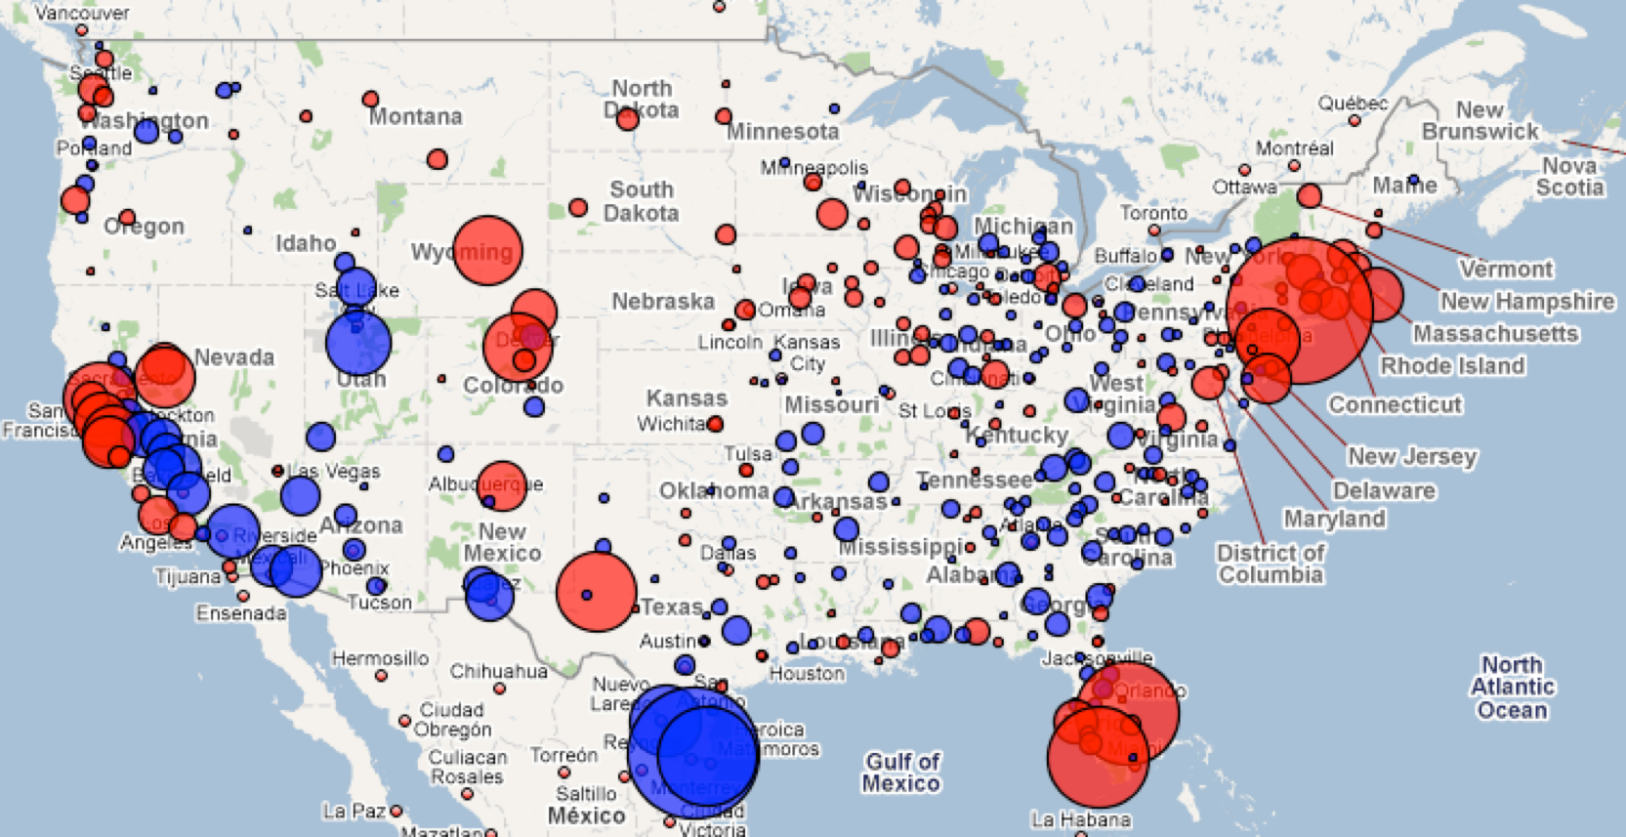
Correlations between deviations and spatial structure
A.
B.
C.
Cross correlations explain only 5-15% of the variation.
D.
E.
income
Notes:
We can do other interesting things with SAMIs, such as they mutual correlation (top line) and their spatial statistics. We see that there is some additional information to the independent scaling relations, showing some correlations between deviation in patents, income and violent crime: richer cities tend to have more patents and less crime, but I note a bunch of exceptions (cities far from the grey lines in the radar plots). The spatial statistics is also interesting: Note for example the start pattern between coastal California and the inland Valley, with radically different fates over this period. Cities are more similar when they are close together but only within 200 km or so…

Slide 19
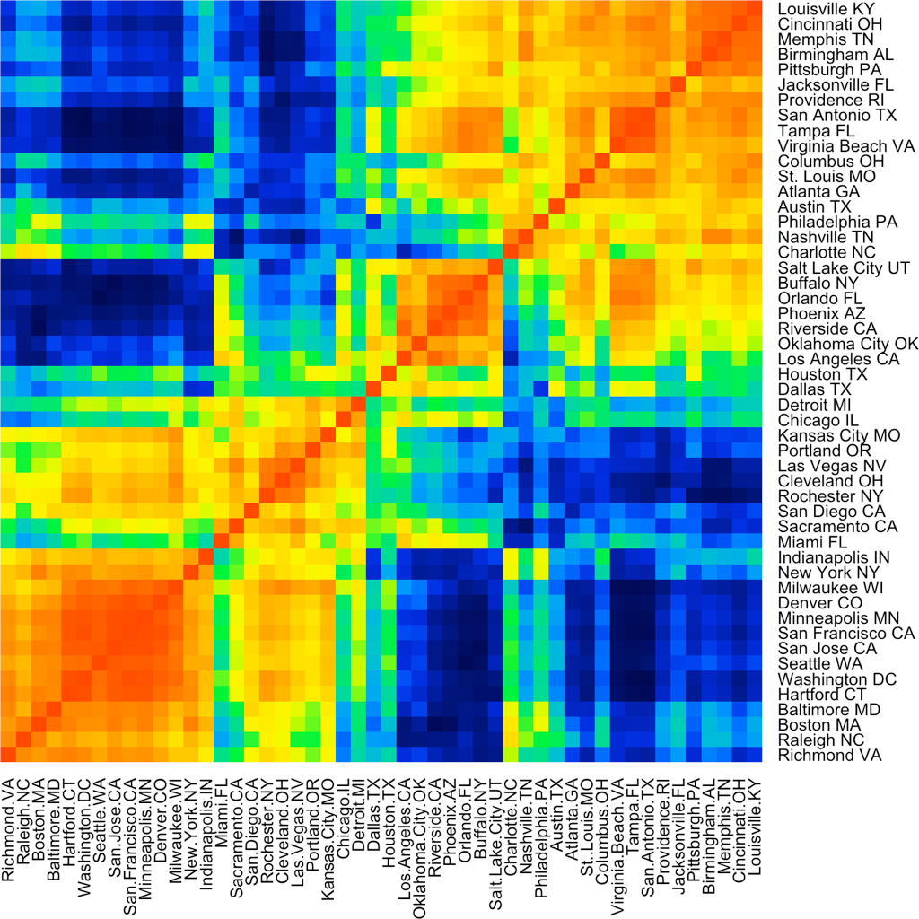
Heat maps from Urban History Clustering Analysis
The concept of kindred cities
cities with similar histories of exceptionality
income
Notes:
Clustering these deviations (or their trajectories as done here) allows us to identify families of “kindred” cities. Note that there are different distances between trajectories leading to different families: typologies are never unique - they depend on quantity compared and the kind of comparison used.

Slide 20
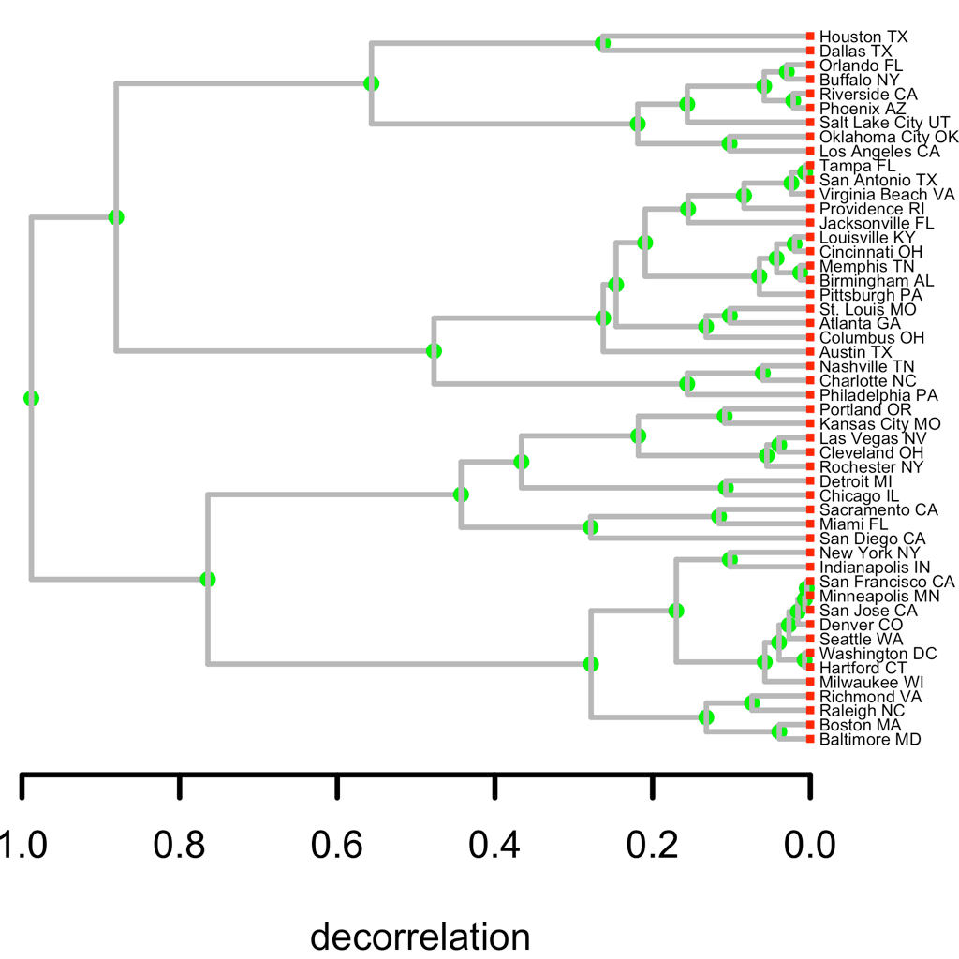
The concept of kindred cities
cities with similar histories of exceptionality
Notes:
This is another view of the families of kindred cities from clustering. We can say that there are - for example- 4 families of cities (red dashed line) at 50% similarity.

Slide 21
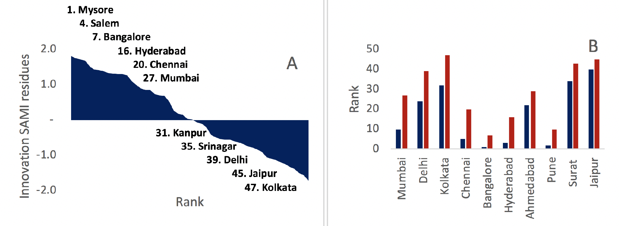
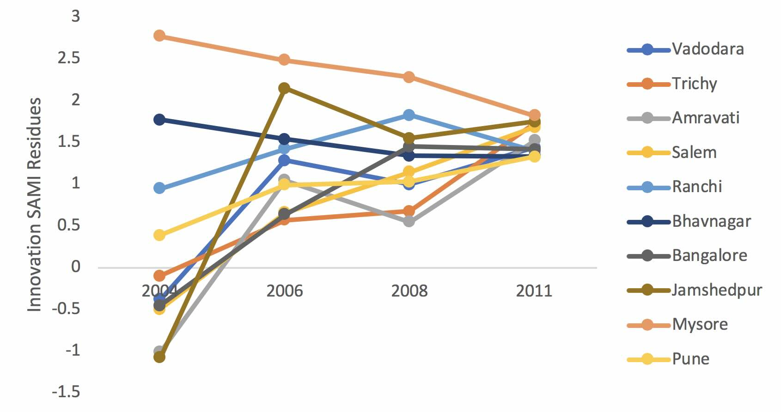
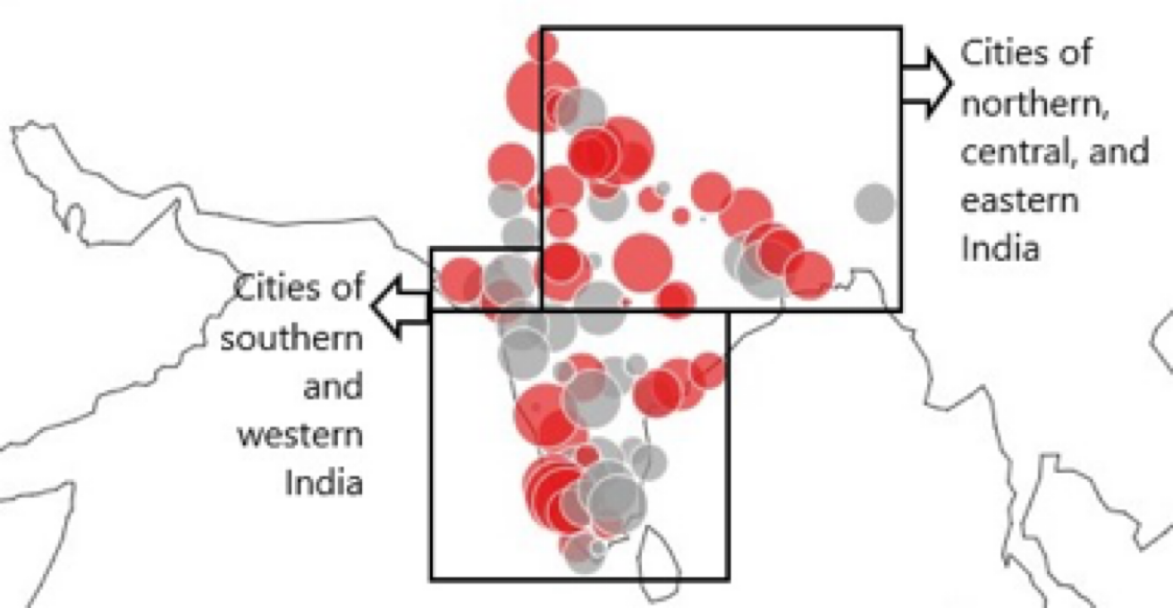
A.
B.
scaling rank
Patents in Indian Cities
discovery of small innovative cities
per capita rank
C.
D.
http://www.royalsocietypublishing.org/doi/10.1098/rsif.2018.0758
Notes:
This kind of procedure is general, even if the stories that emerge for each city, and families of cities, are unique. Here it is for patents in Indian cities.

Slide 22
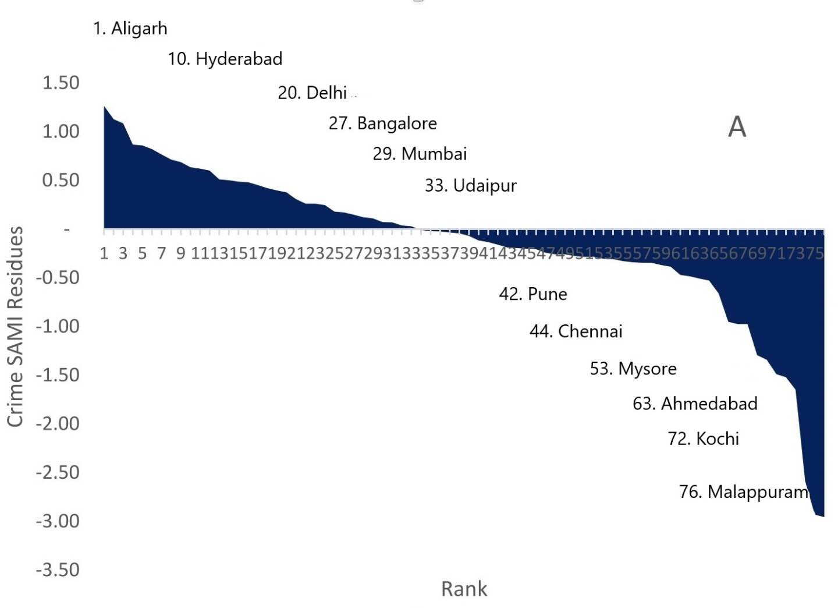
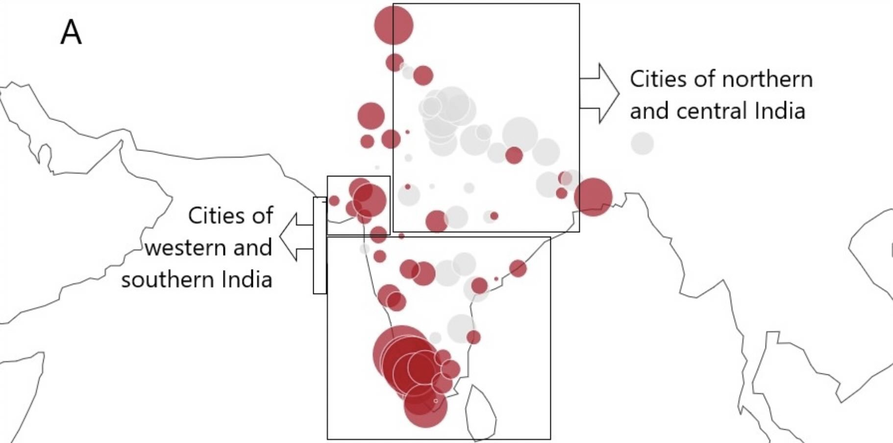
most criminal
http://www.royalsocietypublishing.org/doi/10.1098/rsif.2018.0758
Crime in Indian Cities
least criminal
most criminal
least criminal

Slide 23
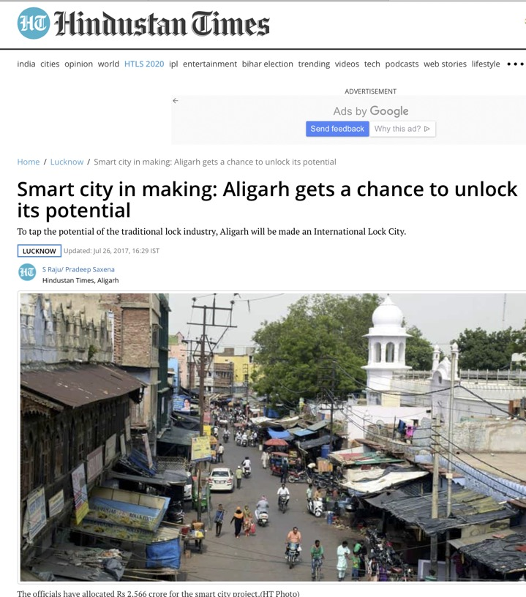
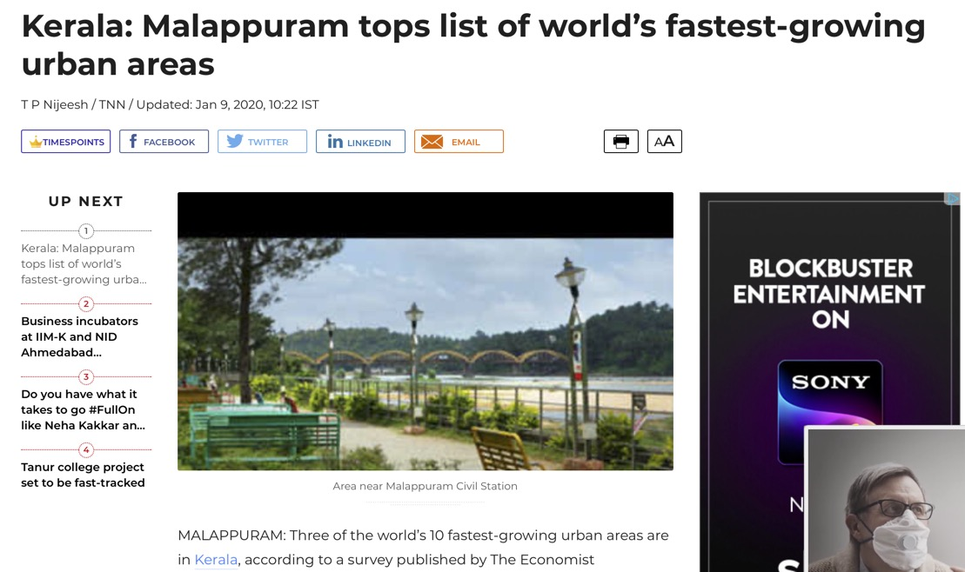
Most innovative
http://www.royalsocietypublishing.org/doi/10.1098/rsif.2018.0758
safest
Notes:
Here is some information about these cities.

Slide 24
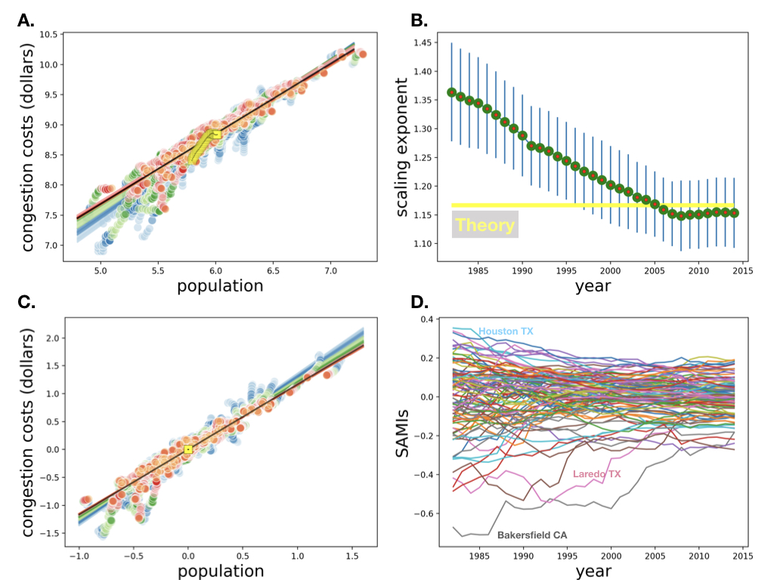
https://royalsocietypublishing.org/doi/10.1098/rsif.2019.0846
Road Congestion US MSAs
exponent
City indicator trajectories
Centered data
Notes:
This is another example, studying the evolution of road congestion measures in US metro Areas. The behavior of the dats is somewhat strange at first perhaps, with larger cities much more congested (exponent larger than 7/6) but over time decays and seems to stay around that value. This is partly the result of smaller cities becoming more congested as A. shows.

Slide 25
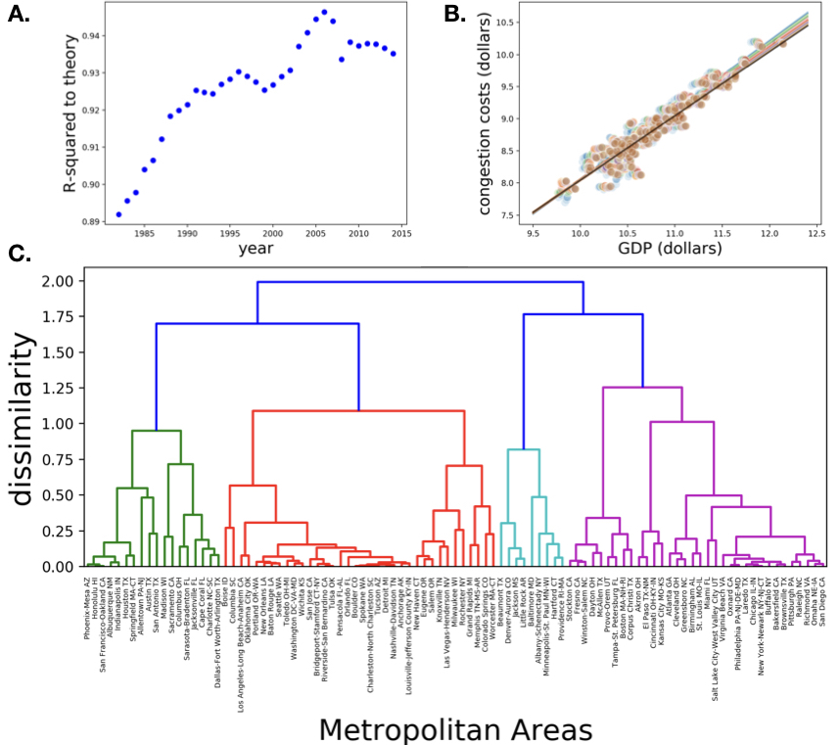
linear
about 1% of GDP is lost in extra congestion
Typologies of changing congestion
Notes:
And these are the families of cities, using the same methods.

Slide 26
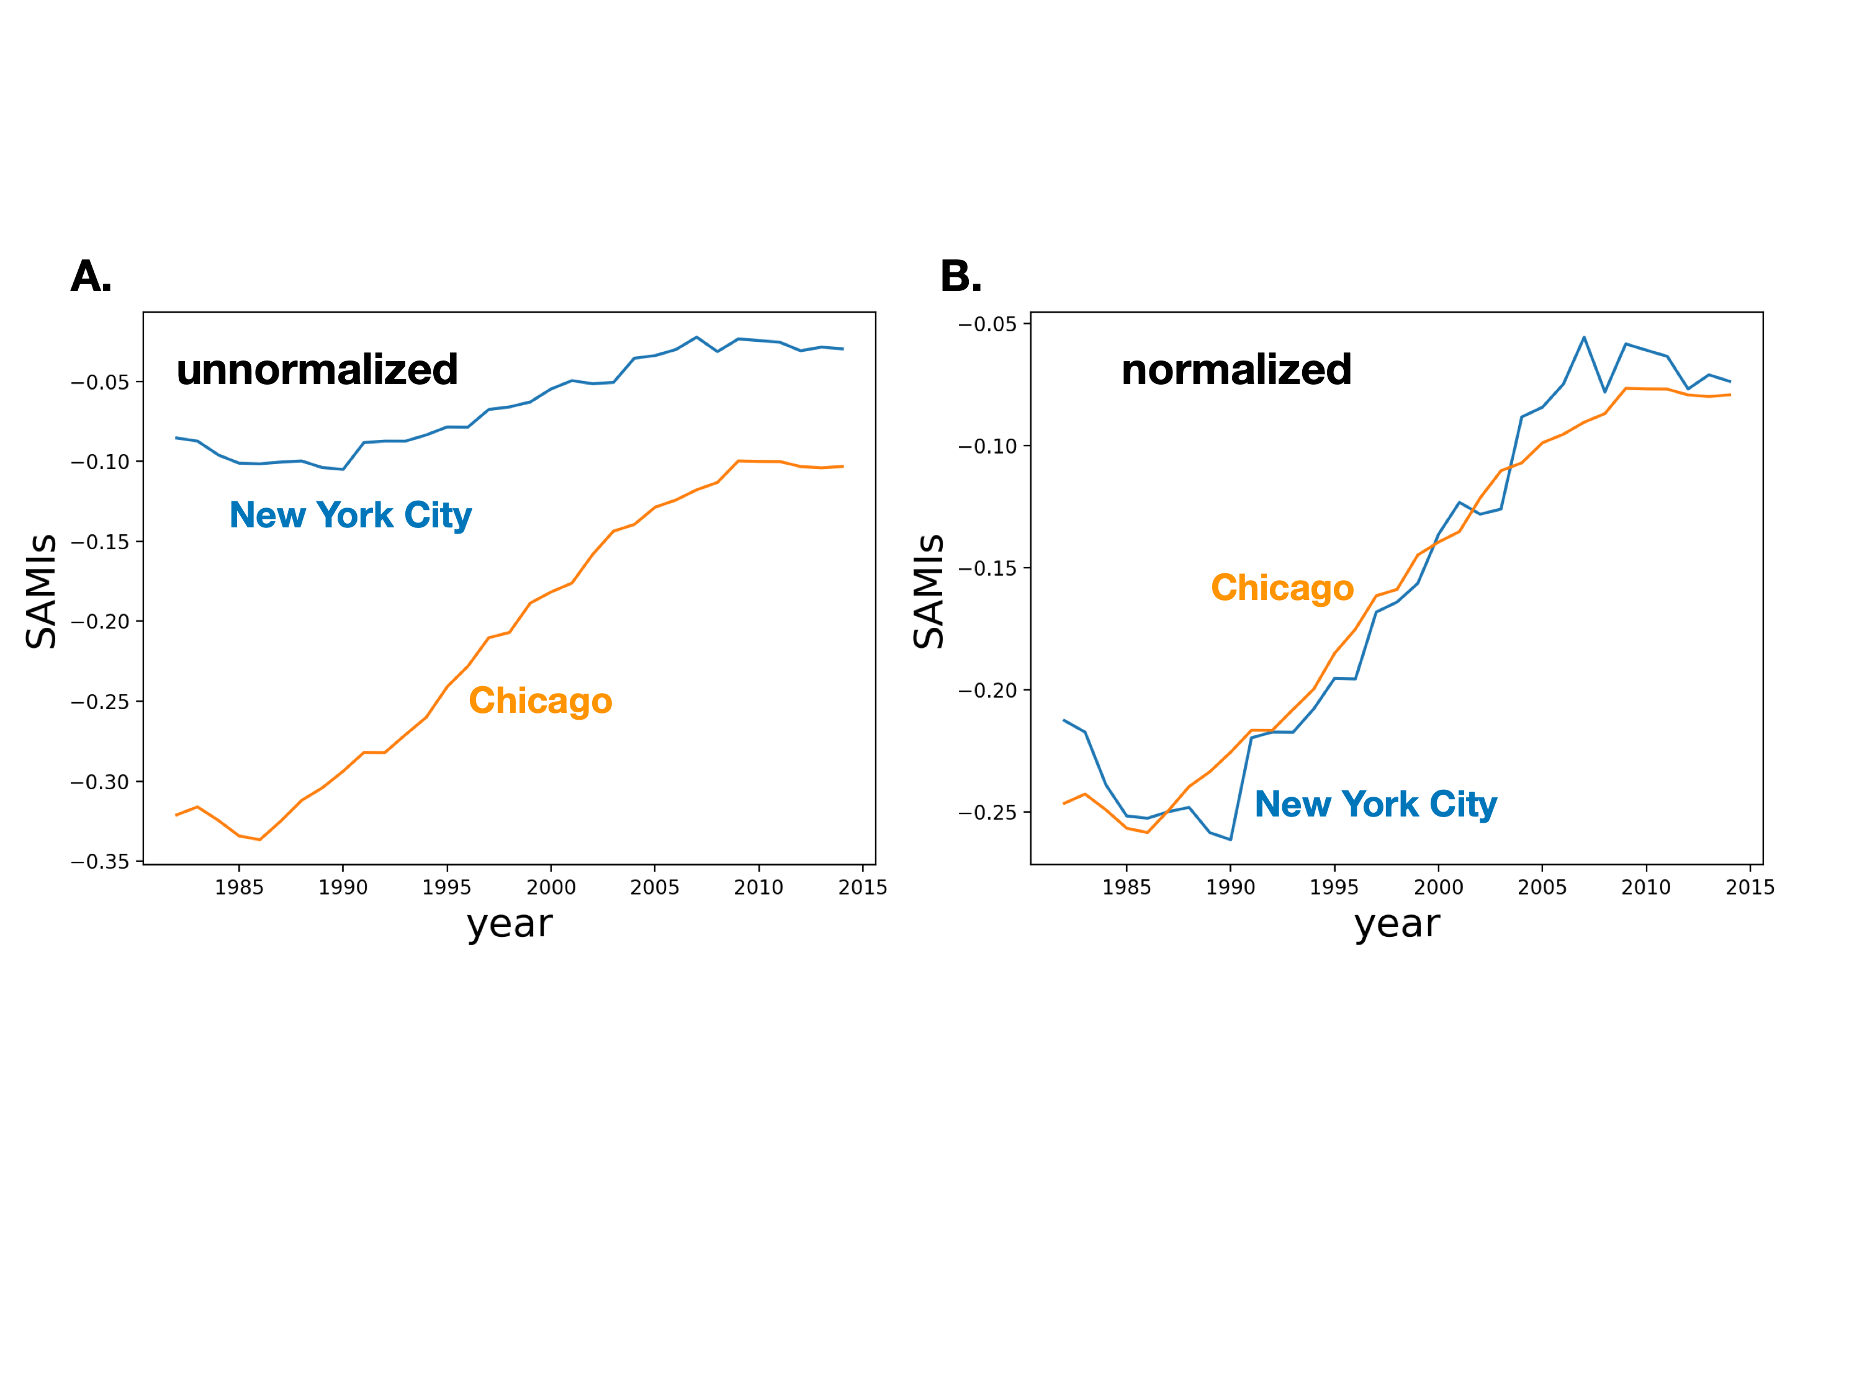
Typologies are not general: they depend on measures of similarity
$$\overset{⃗}{ξ}→\frac{\overset{⃗}{ξ}}{|ξ|}:\underset{t}{∑}\overset{⃗}{ξ}.\overset{⃗}{ξ}=1$$
$$\overset{⃗}{ξ}=(ξ(t_{0}),ξ(t_{1}),...,ξ(t_{n}))$$
Notes:
This shows that depending on the type of distance between metrics in this case formalizing by the magnitude of the deviation or not, two cities may appear very similar (right) or not so much (left). So again, typologies (kindred city families) are contingent on these choices.

Slide 27
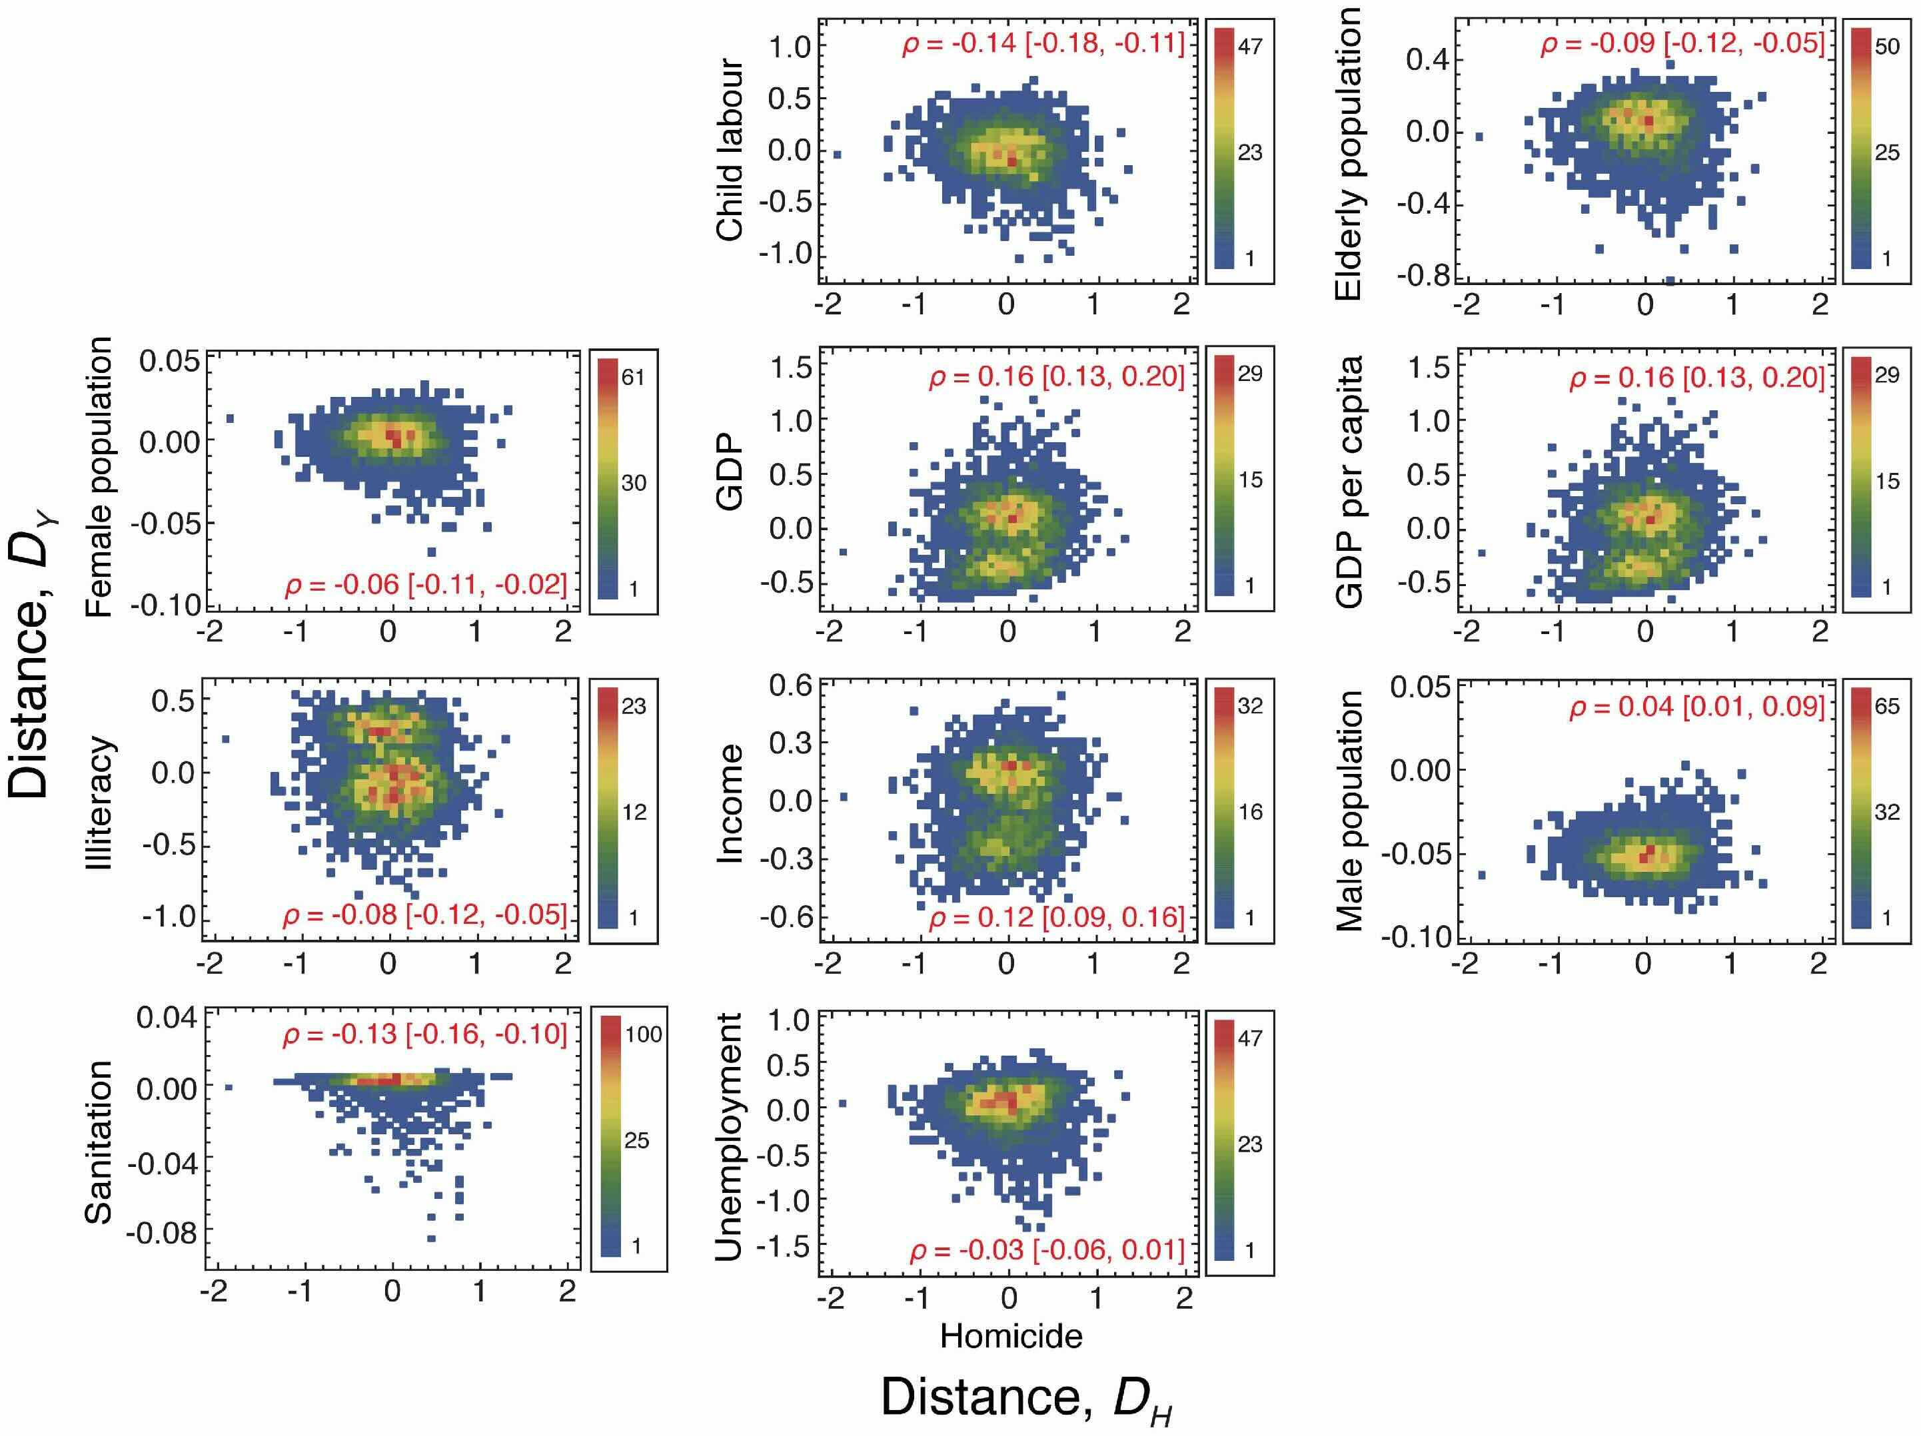
Homicides in Brazilian Cities
$$ξ_{otherquantities}$$
https://journals.plos.org/plosone/article?id=10.1371/journal.pone.0134862
http://dx.plos.org/10.1371/journal.pone.0069580
$$ξ_{homicide}$$
Notes:
This is an example for crime and various socioeconomic quantities in Brazil. Note that correlations are usually weak, but some of the structures are interesting.

Slide 28
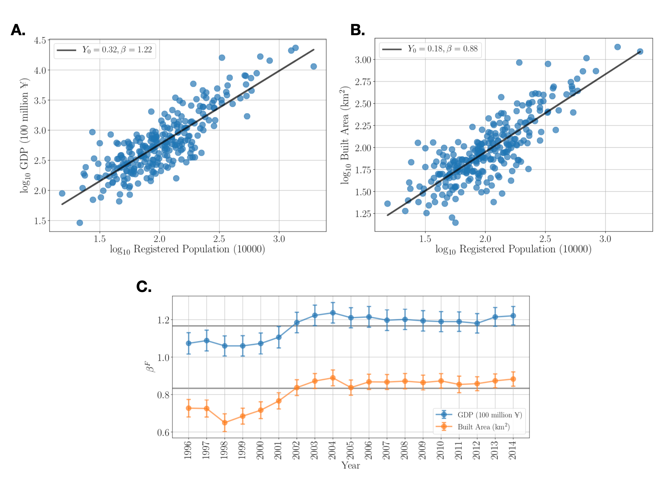
Chinese Prefectural Cities
http://dx.plos.org/10.1371/journal.pone.0221017
Notes:
And, coming back to China, …

Slide 29
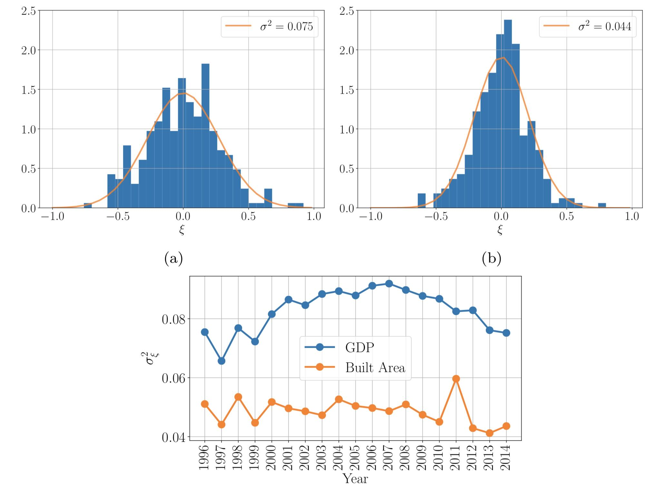
A.
B.
Approximately Normal Distributions
means lognormal statistics for GDP and Built Area
C.
Varying dispersion
http://dx.plos.org/10.1371/journal.pone.0221017
Notes:
The statistical distribution of SAMIs in China : it is thought that this data is not great quality… but it is hard to assess errors and any biases. In general the standard deviations are larger than for other countries, suggesting perhaps larger random errors.

Slide 30
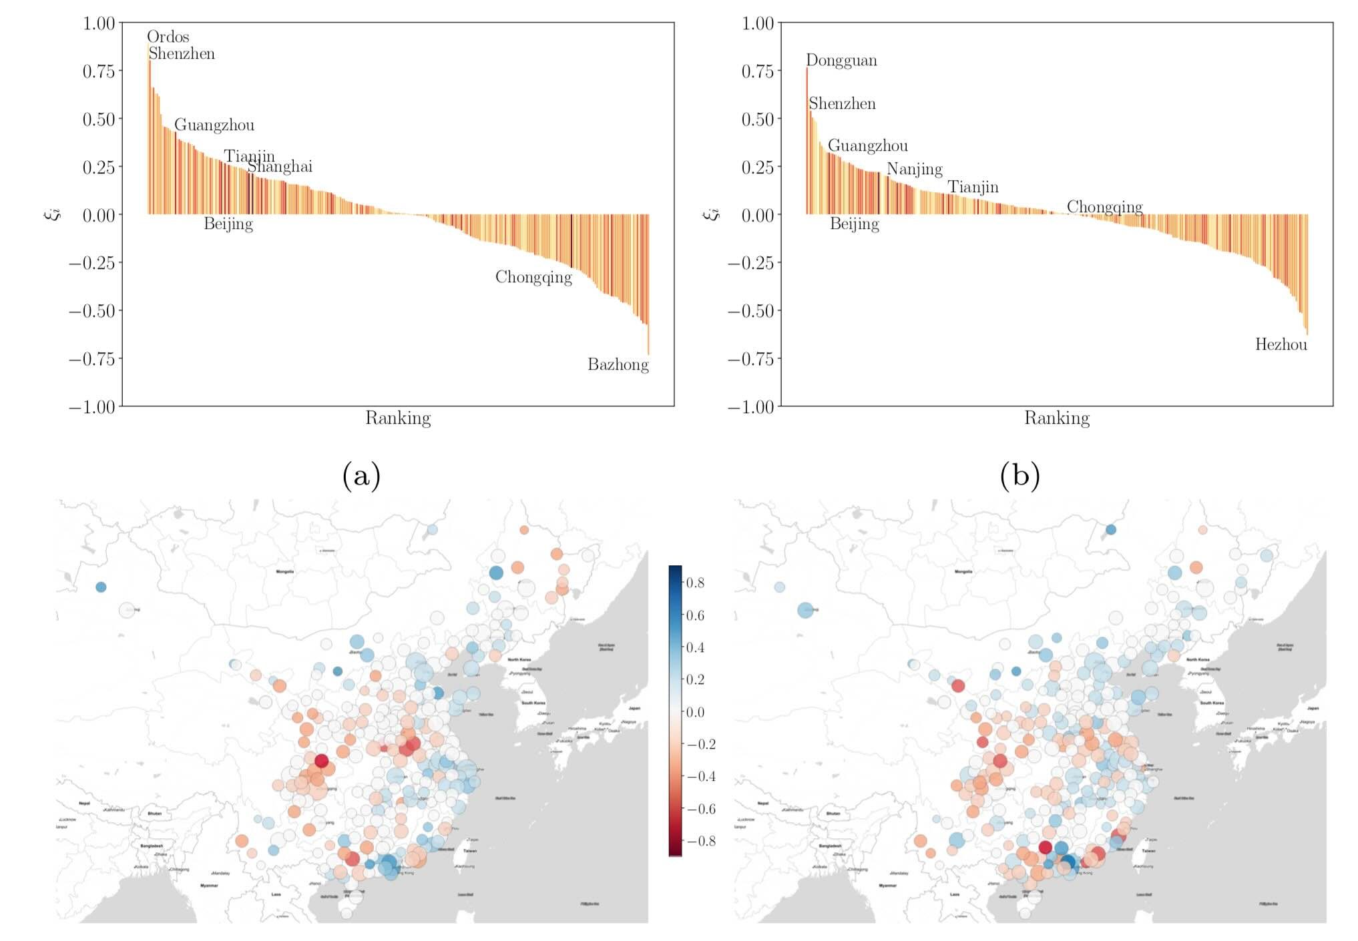
A.
B.
Built Area
GDP
C.
D.
http://dx.plos.org/10.1371/journal.pone.0221017
Notes:
And here is the spatial and ranking analysis…

Slide 31
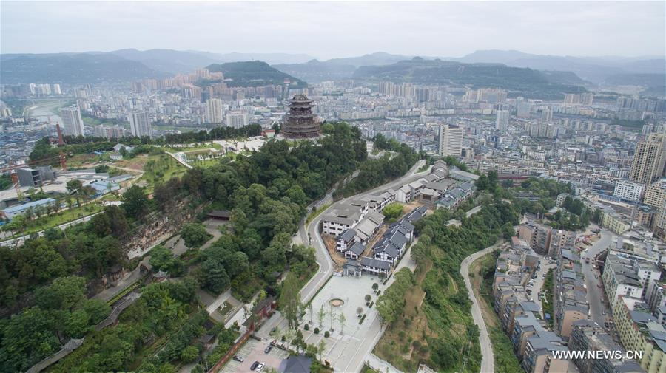
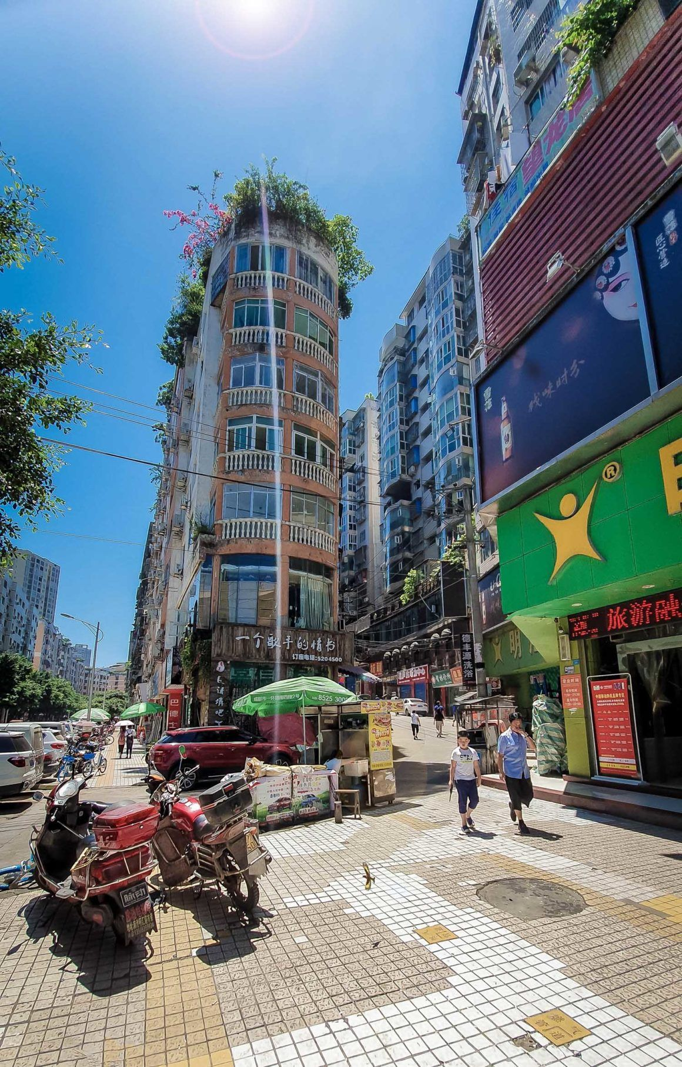
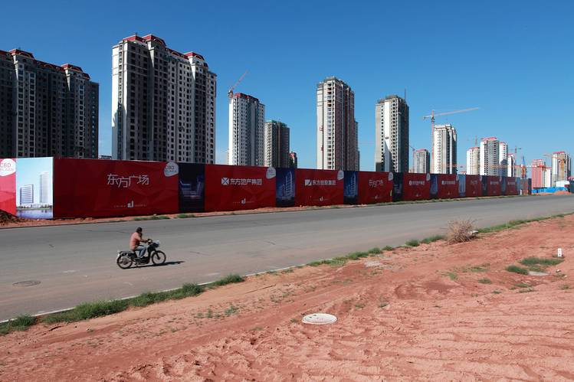
Bazhong, China
most built area per person
Ordos, Inner Mongolia
“Dense City”
“Ghost City”
least built area per person
Notes:
With some stories. Ordos is a famous “ghost city” which over built its housing and infrastructure.

Slide 32

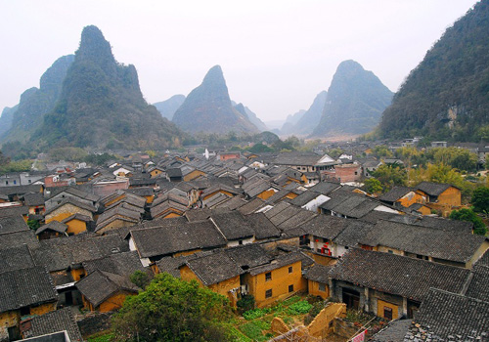
highest GDP per person
lowest GDP per person
Dongguan
Hezhou
Notes:
Cities of the greater Bay Area are known to be richer, but for a variety of reasons, from high tech to entertainment and gambling.

Slide 33
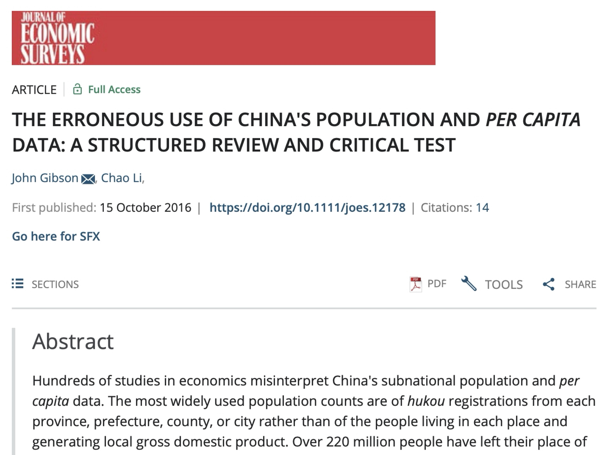
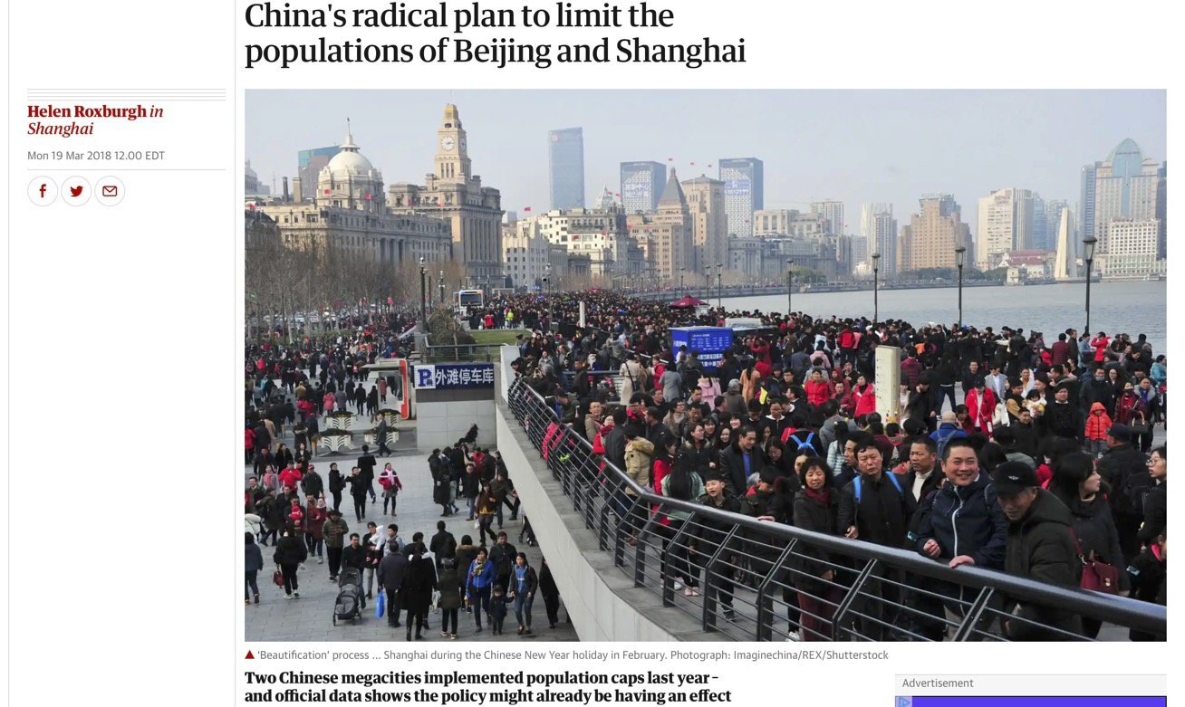
The Hukou System and Population Counts in Chinese Cities
https://www.theguardian.com/cities/2018/mar/19/plan-big-city-disease-populations-fall-beijing-shanghai
Notes:
The population used in these studies is the legal resident population (by the Hukou system): China’s immigration system.

Slide 34
Chinese Prefectural Cities
http://dx.plos.org/10.1371/journal.pone.0221017
Notes:
Notice that the majority of points for large cities are above the scaling line. This is a sign of a bias. Notice also that if the actual population of these cities is higher they would move to the right (as shown by the arrow). We can therefore use the scaling relation to estimate the missing population.

Slide 35
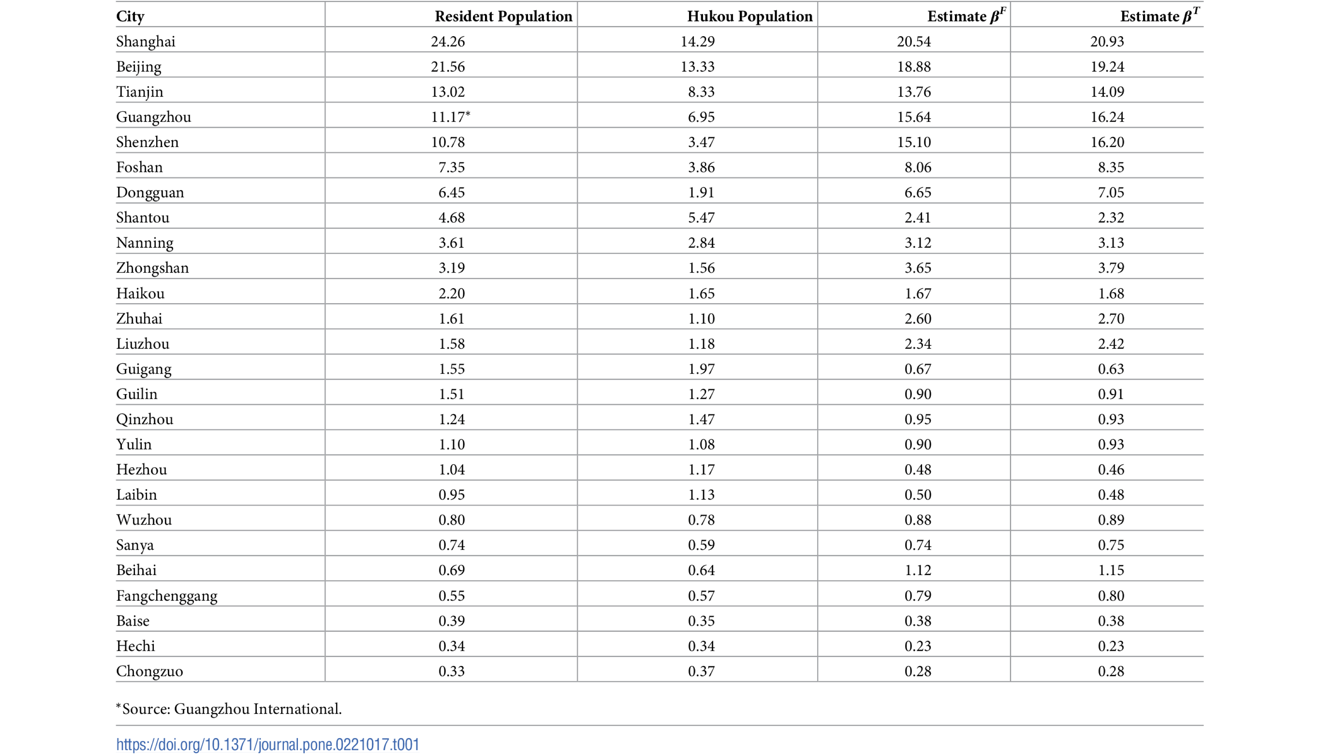
Estimates of actual populations from theory

Slide 36
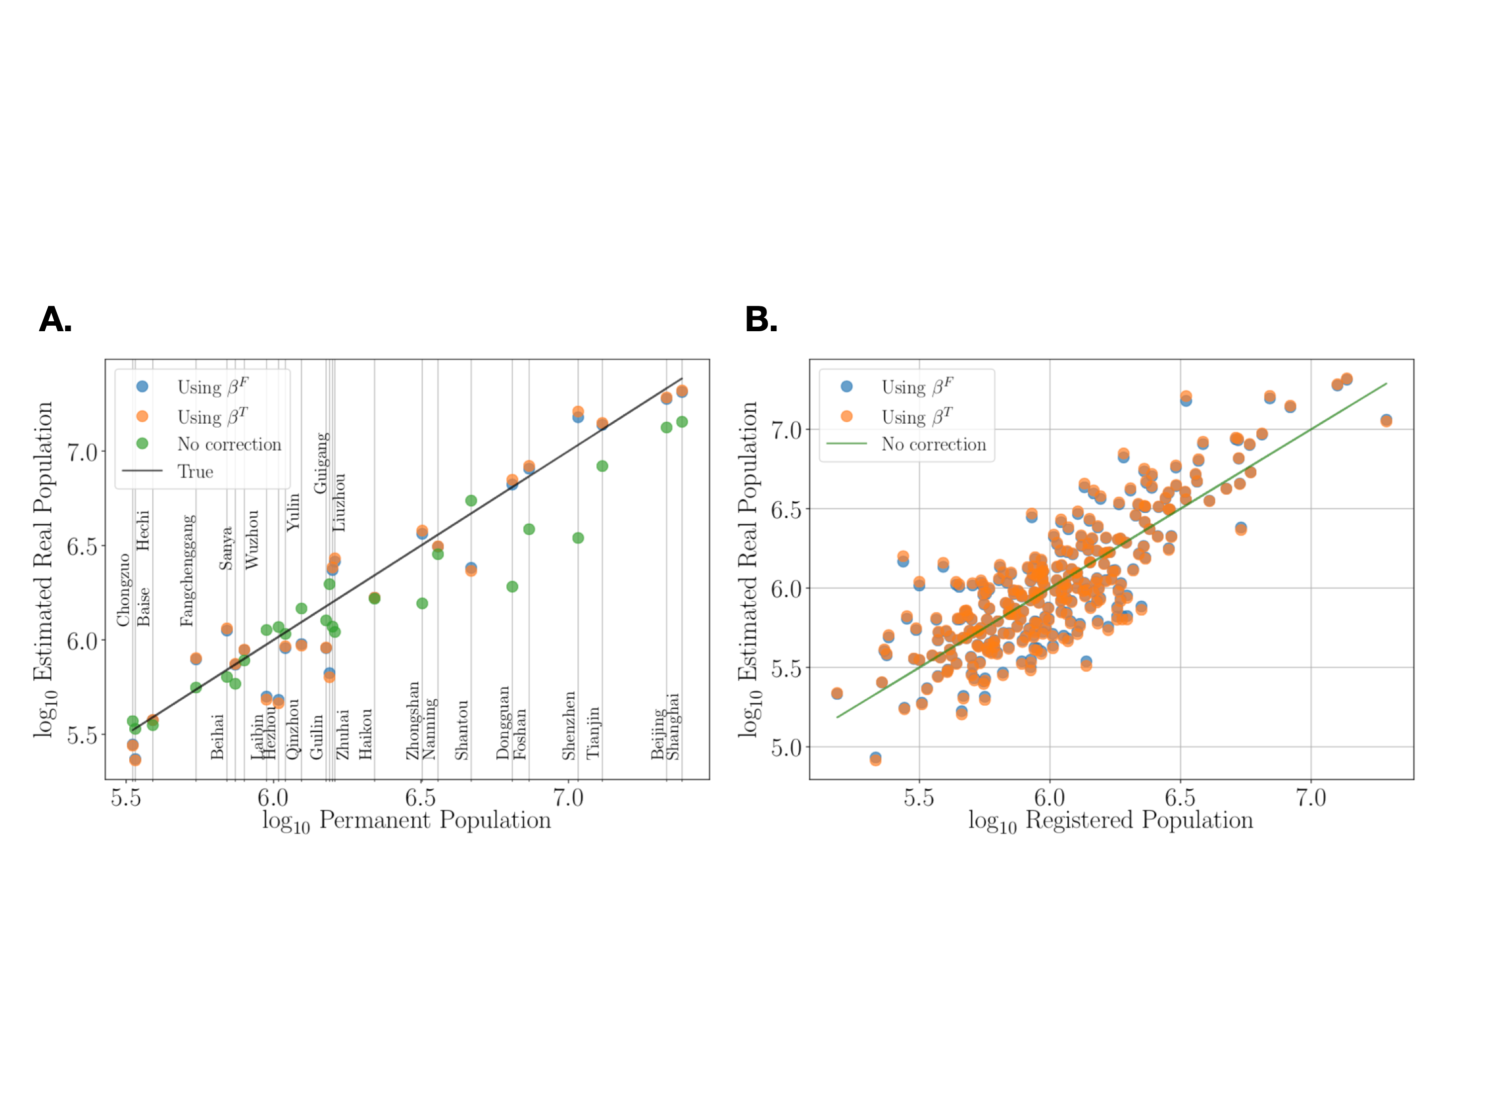
We can also use scaling relations as theory that helps us correct biased statistics
The actual population of large cities in China
https://journals.plos.org/plosone/article?id=10.1371/journal.pone.0221017
Notes:
This gives a much better estimate of the population where there is census data.

Slide 37
So we can start to peel the onion, layer after layer of the structure of cities
From how cities work in general as networks (scaling) to the local flavor of each place (residuals)
From a general theory, to (additional!) more local theories
There will be some general aspects of diversity and inequality in cities, and some particulars and so on…
Notes:
This idea that there is not a single general theory, but rather more global theories, that require additional details as we go down to each city, and then each neighborhood is very important. It is what allows us to connect general urban science with more particular observations and explanations in many social sciences.

Slide 38
What about urban planning and policy?

Slide 39

https://www.brookings.edu/articles/beyond-food-deserts-america-needs-a-new-approach-to-mapping-food-insecurity/

Slide 40
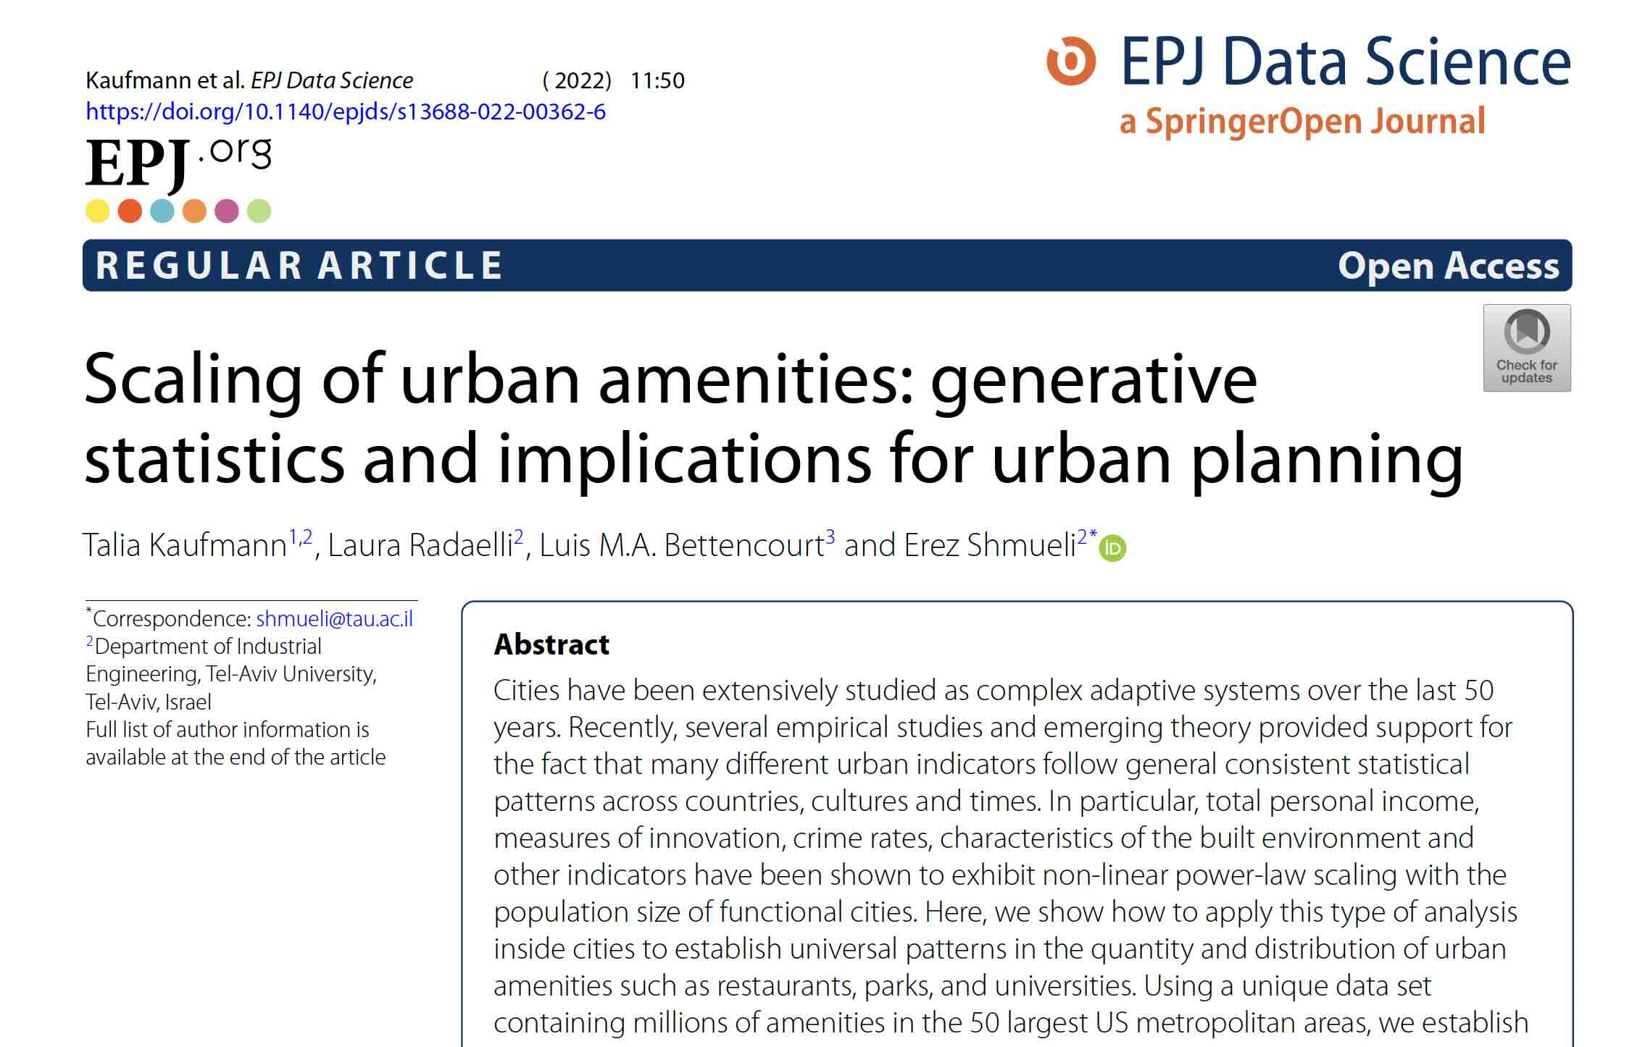

https://link.springer.com/content/pdf/10.1140/epjds/s13688-022-00362-6.pdf

Slide 41
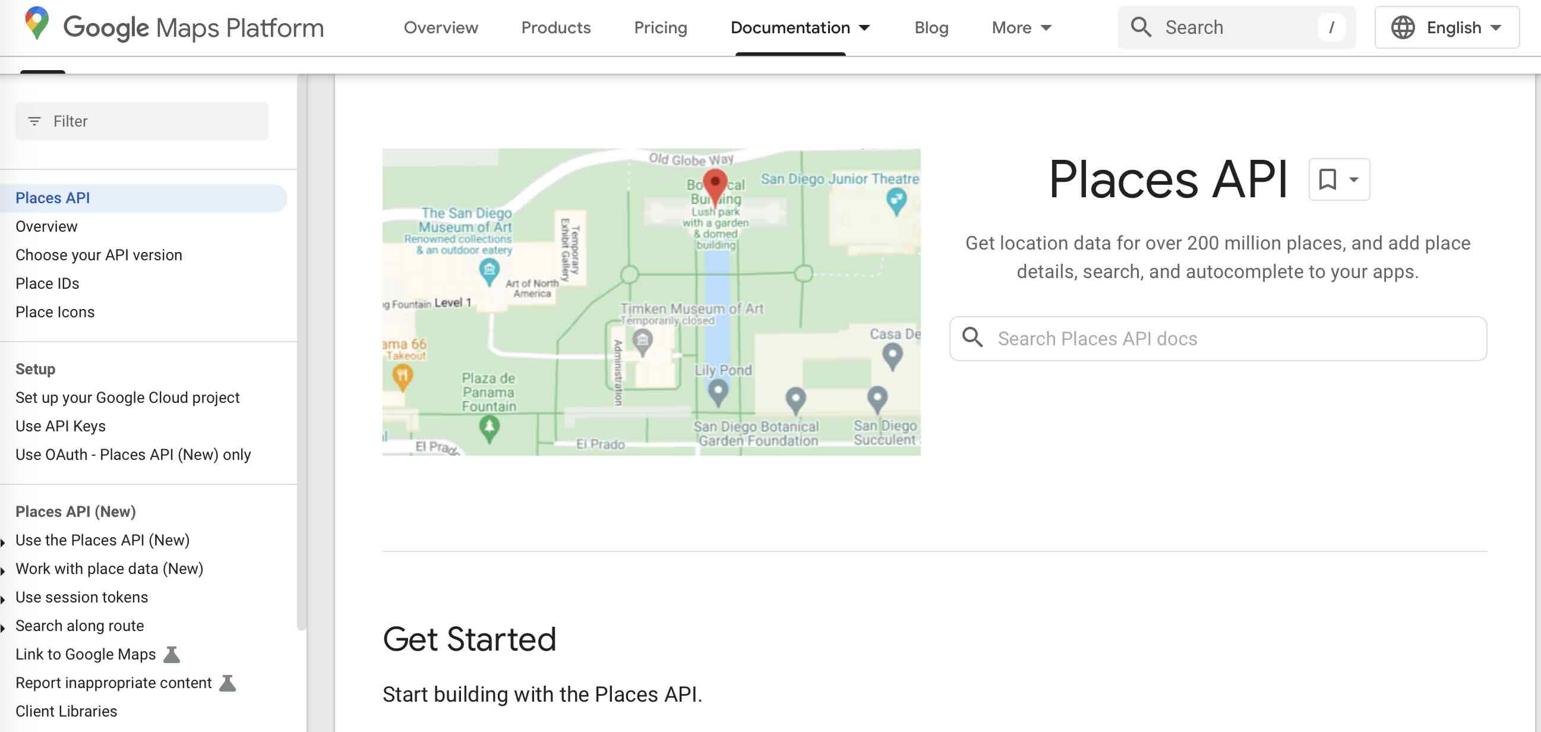
https://developers.google.com/maps/documentation/places/web-service

Slide 42
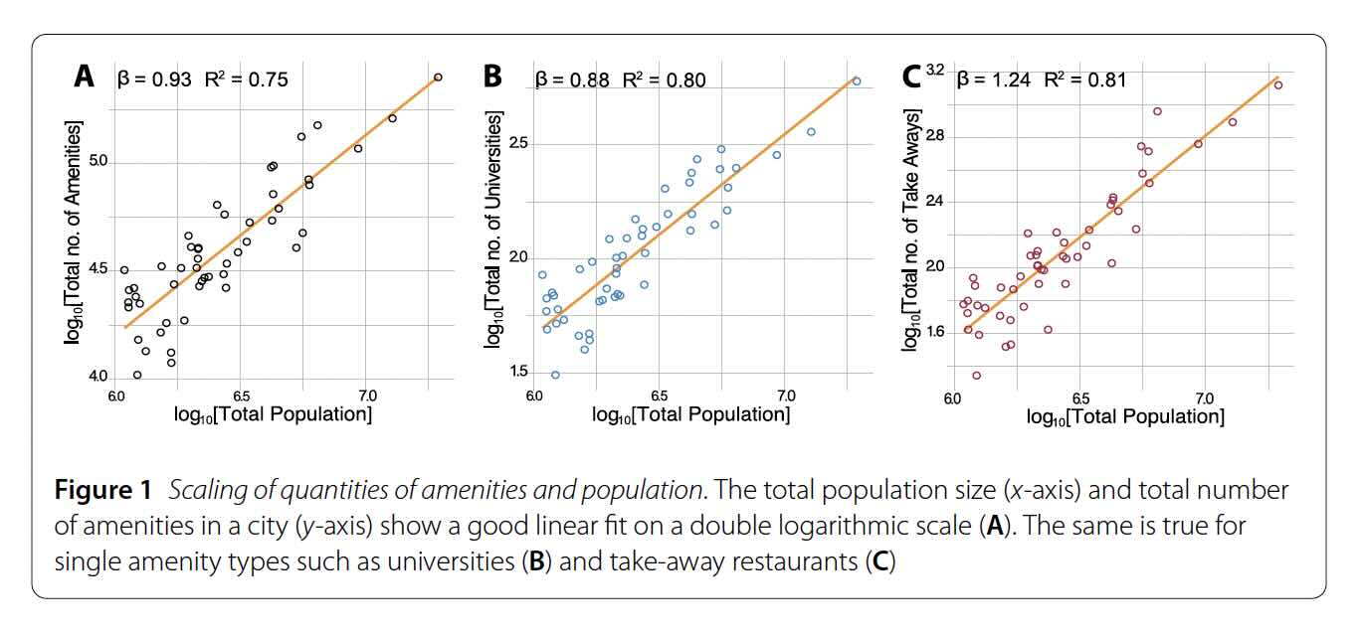

Slide 43


Slide 44

Houston: very uneven
$$λ=0.26$$
km^2 / restaurant
San Francisco: very even
$$λ=0.04$$
km^2 / restaurant

Slide 45



Slide 46


Slide 47


Slide 48
Comparative studies of cities and districts can be made quantitative and statistical
both to reveal the flavor of special places and deficits in services

